Slide 1
OSHA On-Site Consultation Program
Administered by the BWC

Slide 2
Program Overview
Voluntary
Small employers
<250 employees on site
<500 corporation-wide
High hazard industries
Funding: 86% federal; 14% state (BWC)

Slide 3
Services
Identification of Hazards
Industrial Hygiene (Noise, Air Monitoring, Ventilation, Controls)
Assessment of Safety & Health Management System

Slide 4
BWC Division of Safety & Hygiene
OSHA
On-Site
DSH
PERRP

Slide 5
OSHA
Enforcement
Citations, fines
Federal employees
Here to save you
Consultation
Free Service
State employees
Here to save you

Slide 6
On-Site Visits
Opening Conference
Walk-through
Closing Conference
Written Report
Summarizes results of the visit
Mailed after visit ends

Slide 7
SHARP
Safety and Health Achievement Recognition Program
Exemption and recognition program
Employers are removed from OSHA’s programmed inspections schedule

Slide 8
SHARP Requirements
<250 employees on site, <500 corporate-wide
1 year operating history
Incidence rates < industry average
2-3 on all attributes on Form 33 (Safety and Health Program Assessment Worksheet)

Slide 9
Incidence Rates
www.bls.gov/iif
National Data >> Nonfatal II Data
Summary Tables - Incidence rates (XLSX)
Total recordable cases and Total with days away from work, job restriction, or transfer (Columns C and D)

Slide 10
Form 33
Operational
Failure to find
Failure to fix
Managerial
Evaluation of current status
Assignment of responsibilities
Cultural
Leadership involvement
Employee involvement
Effective training
Notes:
Leading v Lagging indicators

Slide 11
Scoring
The following scale is used for scoring the items:
0 | No indication that the item is even partially in place
1 | Some portion or aspect is present though major improvement is needed
2 | Item is largely in place with only minor improvements needed
3 | Item is completely in place

Slide 12
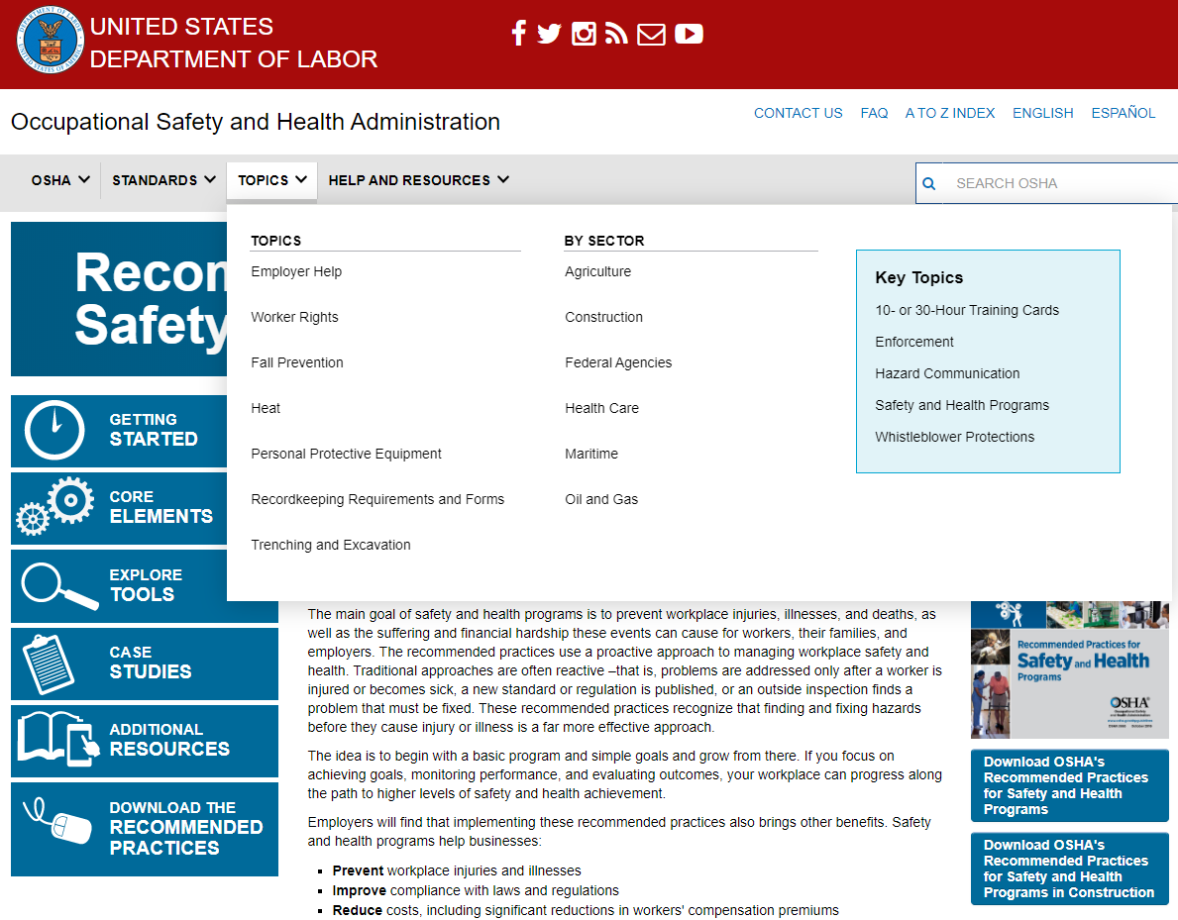
Online Resources
Notes:
Under Explore Tools, self-evaluation, checklist, and audit worksheet.

Slide 13
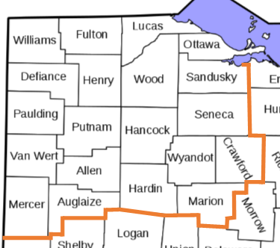
My Service Area
Notes:
Under Explore Tools, self-evaluation, checklist, and audit worksheet.

Slide 14
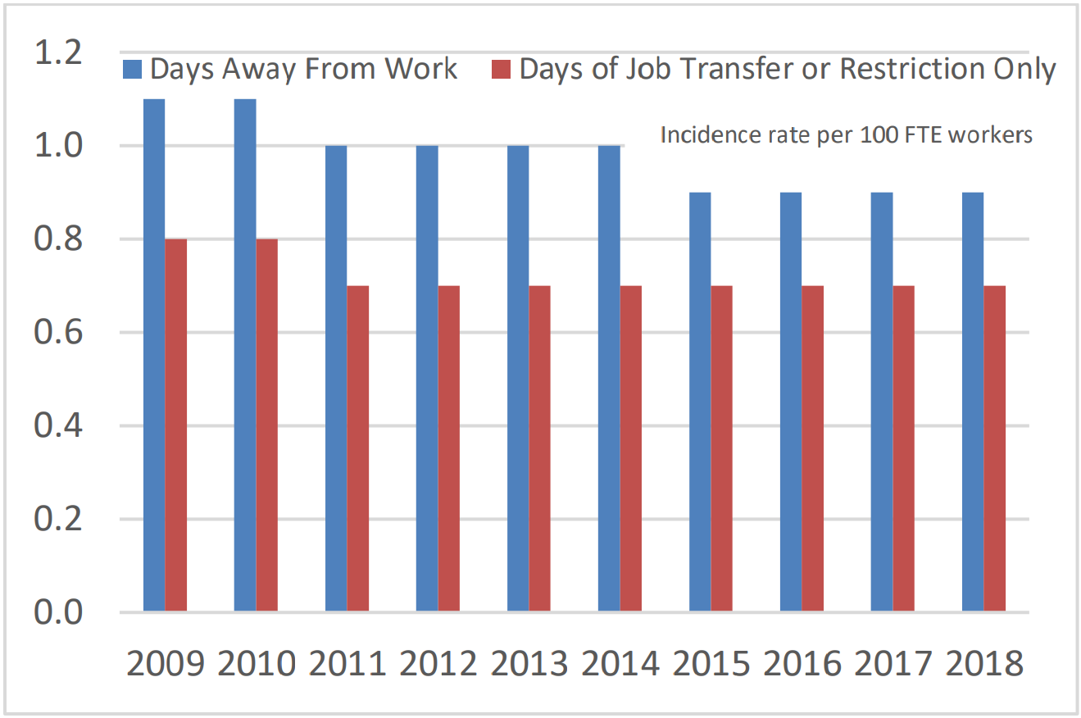
BLS IIF 2018 UPDATE

Slide 15
OSHA Initiatives
Safety and Health Programs
Safe + Sound Campaign
Preventing Trenching Incidents
Suicide Prevention
Work Zone Awareness
Grain Safety Campaign
Fall Prevention Campaign
Heat Illness Prevention
Protecting Young Workers
Workers Memorial Day

Slide 16
ICYMI
Department of Labor v. Chambers Construction Co.
DIRECTIVE NUMBER: CPL 03-00-022 EFFECTIVE DATE: 12/10/2019
SUBJECT: National Emphasis Program on Amputations in Manufacturing Industries
Site Specific Targeting (SST)
Inspection Plan
U.S. Department of Labor to Hold Public Meeting
On Leading Indicators for Safety and Health Programs

Slide 17
National Emphasis Programs
Combustible Dust
Amputations
Hexavalent Chromium
Lead
Primary Metal Industries
Process Safety Management
Shipbreaking
Crystalline Silica
Trenching and Excavation

Slide 18
Regional Emphasis Programs
Building Renovation
Grain Handling Facilities
High Rise Building Construction
Powered Industrial Vehicles
Wood Pallet Manufacturing
Fall Hazards

Slide 19
Contact Us
Phone Call
800-282-1425 – State-wide (Automated)
614-644-2631 – State-wide
419-205-4149 – NW Ohio employers
Laura Mattimoe
E-mail
Laura.Mattimoe@bwc.state.oh.us
OSHAOn-SiteRequest@BWC.State.OH.US

