Slide 1





WELCOME EVERYONE
West Central Ohio Safety Council
April Monthly Meeting

Slide 2

TODAY’S AGENDA
8:00 am: Meeting Begins with Announcements
Deb – SC updates and External Training Opportunities
Julie Klingler, Director of Programs and Community Connections at the Chamber – sharing Chamber programs
BWC Updates from Butch Blankenship *Deb is playing Butch this month
Keynote Speakers Presentation
Volunteer for June 20th at West Ohio Food Bank
Meeting Wrap-Up - Pull 50/50 Winning Number
Meeting Adjourned by 9 am
***SLIDES WILL BE SHARED WITH ATTENDEES AFTER THE MEETING AS WELL AS THE ATTENDANCE

Slide 3

APRIL IS NATIONAL VOLUNTEERING DAY
West Central Ohio Safety Council is promoting a day at the West Ohio Food Bank helping with various tasks.
April 20th, 9:30 – 1:30
Work 9:30-11:30, 11:30-1:30, or BOTH
If you are interested, let me know before the end of the day TODAY!
WOFB is waiting for me to share the number of helpers, etc.

Slide 4


FY2026 CHARITIES
SAVING GRACE FARM MINISTRIES
ALLEN LIMA LEADERSHIP’S TEDDY BEAR FUND
The Mission of Saving Grace Farm Ministries is to provide an atmosphere for the rescue, redemption and restoration of emotionally wounded people and horses, each using the other as instruments to renew hope, rebuild trust and foster healing through the knowledge of grace found in Jesus Christ.
The Allen Lima Leadership Teddy Bear Fund is a charitable initiative aimed at supporting children in need within the community. By providing teddy bears and other comforting items, the fund seeks to offer emotional support and a sense of security to children facing challenging circumstances, such as illness or family hardships.
3

Slide 5
BUY YOUR 50/50 RAFFLE TICKETS NOW
For Sale at the registration table Now accepting Venmo
6 tickets for $5
1 ticket for $1

Slide 6

STEERING COMMITTEE MEMBERS
President: Amy Ricker, Lima Pallet Co. | Joe Hutton, Fort Amanda Specialties
Vice President: Crystal Jackson, Cenovus- Husky Lima Refinery | Tony Daley, Spallinger Millwright
Past President: Craig Hohenbrink, INEOS | Butch Blankenship, BWC Rep
Jed Metzger, Chamber Liaison | Deb Katzenmeyer, Manager

Slide 7




ATTENDANCE
Safety resources matter — presentation slides will be emailed following today’s meeting.
Need external safety credits? Booklets are available at the registration table, along with learning flyers from BWC.
Stay compliant — please review and verify your attendance throughout the year to ensure accurate safety records.

Slide 8

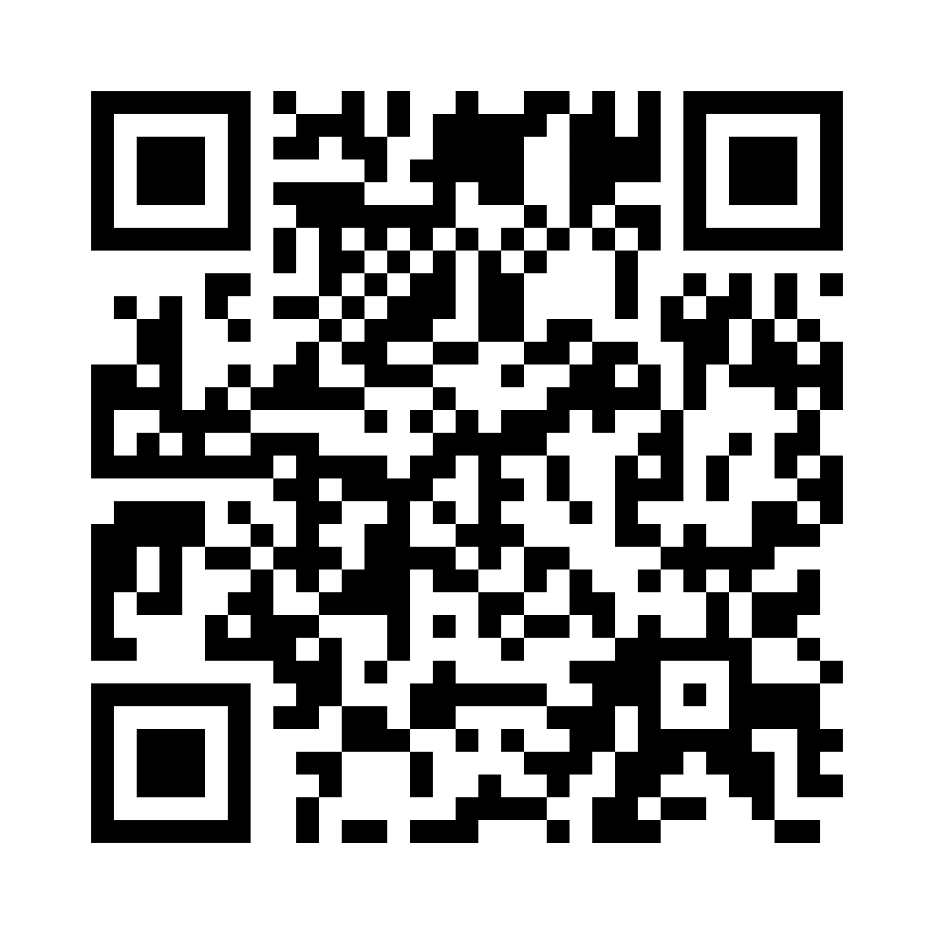
Check attendance - Scan QR Code
Through Today -
There is a printed attendance sheet
at the registration table
Verify your attendance
throughout the year

Slide 9
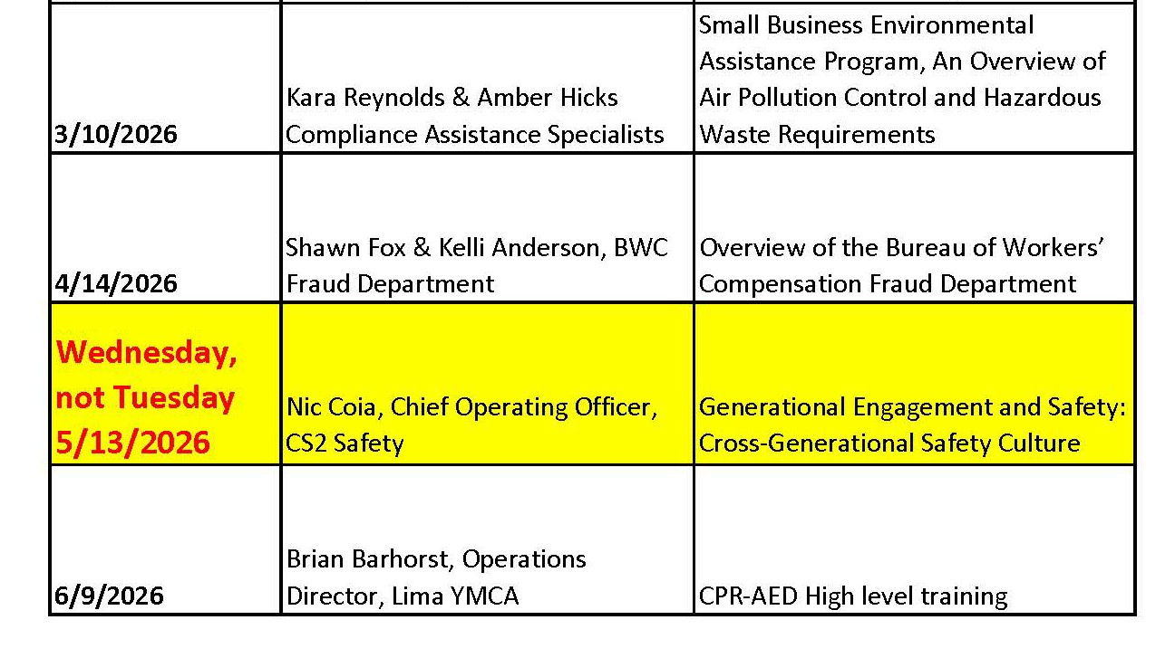
FY 2026 SCHEDULE
7

Slide 10
TRAINING OPPORTUNITIES OUTSIDE OF MONTHLY MEETING
Certified Occupational Safety Specialist
Week of April 27 - May 1, 2026 @ OhioMeansJobs facility

Slide 11
Worker Fraud
Kimberly S. Kondalski

Slide 12
Ohio Rev. Code Ann. § 2913.48(A)(1)
No person, with purpose to defraud or knowing that the person is facilitating a fraud, shall do any of the following:
  1. Receive workers' compensation benefits to which the person is not entitled

Slide 13
Ohio Rev. Code Ann. § 2913.48(B)
Whoever violates this section is guilty of workers' compensation fraud. Except as otherwise provided in this division, a violation of this section is a misdemeanor of the first degree.
If the value of premiums and assessments unpaid pursuant to actions described in division (A)(5), (6), or (7) of this section, or of goods, services, property, or money stolen is one thousand dollars or more and is less than seven thousand five hundred dollars, a violation of this section is a felony of the fifth degree.
If the value of premiums and assessments unpaid pursuant to actions described in division (A)(5), (6), or (7) of this section, or of goods, services, property, or money stolen is seven thousand five hundred dollars or more and is less than one hundred fifty thousand dollars, a violation of this section is a felony of the fourth degree.
If the value of premiums and assessments unpaid pursuant to actions described in division (A)(5), (6), or (7) of this section, or of goods, services, property, or money stolen is one hundred fifty thousand dollars or more, a violation of this section is a felony of the third degree.

Slide 14
Common Examples of Worker Fraud
Working while receiving benefits
Engaging in activities inconsistent with restrictions
Grossly exaggerating the extent of the injury
Claiming an injury at work, but the injury happened elsewhere

Slide 15

2025 Special Investigation Statistics
2,164 allegations
  Closed 1,395 cases in an average of 206 investigative days
818 cases where fraud was found
$91,770,469 identified in savings
  Average closed case identified $65,738 in savings

Slide 16
Results Achieved Since 1994
Allegations | 140,128
Cases Referred for Prosecution | 6,061
Convictions | 3,322
Cases Closed | 76,745
Savings to State Insurance Fund | $2.4 billion

Slide 17
Notable Fraud Cases

Slide 18
Multiple Work Activities
Woman worked for 4 different employers while receiving BWC benefits
Pled guilty to a first-degree misdemeanor
Restitution of $3,816

Slide 19

Withholding Work Activity
Police officer returned to work as a foreman while receiving BWC benefits
Pled guilty to fifth degree felony
  Restitution of $12,501.70 and a one-day jail credit- time served

Slide 20
False Claim Reporting
Parol officer alleged he lost vision in his right eye after a workplace injury
Medical limitations overstated: Claimant received his Commercial Driver’s License and driver’s license
Both require vision tests
Claimant also employed at a local YMCA and Christmas tree farm while receiving benefits
Pled guilty to 23 fifth degree felonies
Restitution of $21,210.10 and sentenced to 23 years of incarceration
Prison sentence was suspended, and he received 4 years of probation

Slide 21

Questions?

Slide 23
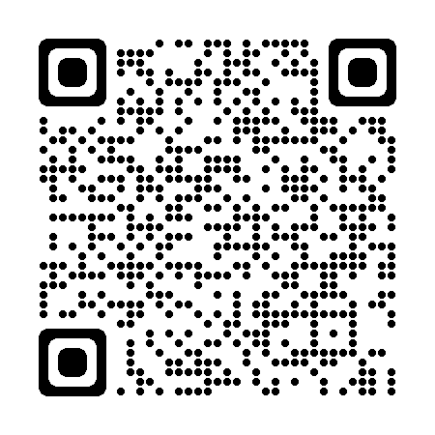
april Safety Council Update
Ohio West Safety Council
Butch Blankenship
bwc.ohio.gov
Industrial Safety Consultant
Toledo Service Office
419-461-4760
butch.b.2@bwc.ohio.gov
Notes:
*REQUIRED SLIDE*
QR Code takes you to BWC website.

Slide 24
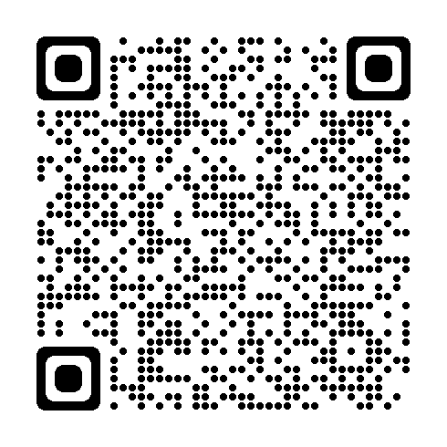


Monthly Learning April - Continued
April 27-30 - Electrical hazard recognition and abatement
Canton Service Office
April 28 - First aid in the workplace
Cambridge Service Office
April 30 - Safety for the non-safety professional
Del-Co Water Co. Wolf Event Center 201, Delaware, OH
bwclearningcenter.com
In-person classes and virtual training classes (VTC) qualify for Safety Council rebate external training credits.
Notes:
*REQUIRED SLIDE*
📢 Register Early – Seats Fill Quickly!
To ensure your spot in these valuable training sessions and workshops, we strongly encourage you to register as early as possible. Many of our classes reach capacity quickly, and we don’t want you to miss out on the opportunity to participate.
.

Slide 25
Monthly Learning May
May 6 - Electrical safety in the workplace through insight and implementation of NFPA 70E
Cincinnati/Springdale Service Office
May 6 - First aid in the workplace
Indiana Wesleyan University, Independence, OH
  May 12-13 - OSHA 10: Industry safety basics
  Independent Electrical Contractors (IEC)
bwclearningcenter.com
In-person classes and virtual training classes (VTC) qualify for Safety Council rebate external training credits.
Notes:
*REQUIRED SLIDE*

Slide 26
Monthly Learning May-continued
May 14 - Emergency preparedness planning half-day workshop
Cincinnati/Springdale Service Office
May 19 - Crisis de-escalation tactics and safe practices
Canton Service Office
  May 20-21 - OSHA 10: Industry safety basics
  Bowling Green State University, Perrysburg, OH
bwclearningcenter.com
In-person classes and virtual training classes (VTC) qualify for Safety Council rebate external training credits.
Notes:
*REQUIRED SLIDE*

Slide 27
Monthly Learning May-Continued
May 21 - First aid in the workplace
Edison State Community College, Piqua, OH
May 21 - Combustible dust hazards: Recognition, evaluation and control recommendations
Indiana Wesleyan University, Independence, OH
  May 28 - Safety for the non-safety professional
  Canton Service Office
bwclearningcenter.com
In-person classes and virtual training classes (VTC) qualify for Safety Council rebate external training credits.
Notes:
*REQUIRED SLIDE*

Slide 28
virtual training April
April 21-22 - Ergonomics: Basic principles
April 29 - Respirators: Do we need them?
bwclearningcenter.com
In-person classes and virtual training classes (VTC) qualify for Safety Council rebate external training credits.
In-person classes and virtual training classes (VTC) qualify
for Safety Council rebate external training credits.
Notes:
*REQUIRED SLIDE*
Why choose virtual training?
Participate without stepping away from your workplace
Access the same expert-led content and interactive discussions
Save time on travel and scheduling
Stay engaged and informed
Whether you're in the office, in the field, or working remotely, virtual training makes it easier than ever to stay connected and continue learning.
Register early to reserve your spot—virtual seats can fill quickly too!

Slide 29
virtual training may
May 5 - Crisis de-escalation tactics and safe work practices workshop
May 7- Accident analysis half-day workshop
May 12-14 - Improving hazard recognition through visual literacy
May 20 - Job safety analysis
May 28 - Safety series workshop module 6: Machine guarding basics and powered equipment basics
bwclearningcenter.com
In-person classes and virtual training classes (VTC) qualify for Safety Council rebate external training credits.
In-person classes and virtual training classes (VTC) qualify
for Safety Council rebate external training credits.
Notes:
*REQUIRED SLIDE*

Slide 30
Private employer important dates – April and May
April - No deadline dates
May 1 - PA PY 2026 notice of estimated annual premium sent (approx. date)
May 15 - PA last date employer can change installment plan for PY 2026
May 29 - PA Risk Management Essentials application deadline for 7/1/2026 start date
Notes:
There are no deadline dates for PA employers for April.
PA & PEC Risk Management Essentials program = Sponsors must notify BWC of their intent to participate by the last business day of April. Sponsors market the program and compile and submit a roster of employers to BWC. Sponsors must file rosters with BWC by the last business day of May. Each program year starts on July 1.
BWC will review to ensure employer eligibility (based on lapse days, current balance, recent true-up submission, and program compatibility). BWC will return a list of eligible participants once the review is complete.
Please note the Risk Management Essentials application deadline is the same for both PA and PEC employers.

Slide 31
Public Employer important dates – April and may
April 15 - PEC Individual retro billing invoice mailed for previous policy year (approx. date)
April 21 - PEC deferred premium payment due (January - May)
May 29 - PEC Risk Management Essentials application deadline for 7/1/2026 start date
May 29 - PEC Group experience rating application deadline for 1/1/2027 start date (must be filed by COB)
Notes:
Please note the Risk Management Essentials application deadline is the same for both PA and PEC employers.

Slide 32

Forklift safety
Notes:
Photo source: Forklift-Truck by Compliance and Safety LLC is licensed under CC BY-SA 3.0
Powered industrial trucks, commonly called forklifts or lift trucks, are used in many industries, primarily to move materials. They can be used to move, raise, lower, or remove large objects or a number of smaller objects on pallets or in boxes, crates, or other containers.
Here are the basics or forklift trucks:
• It has two metal forks (like prongs) that slide under pallets or loads.
• A hydraulic system raises and lowers the forks.
• It’s commonly used in warehouses, manufacturing plants, loading docks, and storage yards.
• A trained operator drives it, comparable to a small vehicle, but it’s designed for heavy lifting and tight spaces.

Slide 33
National forklift safety day – June 9, 2026
The purpose of National Forklift Safety Day
Increase awareness of forklift safety.
Encourage safer behavior while using forklifts.
Highlight the importance of operator training and regular equipment checks.
Notes:
The Industrial Truck Association (ITA), an organization of industrial truck manufacturers and suppliers, created National Forklift Safety Day to highlight the safe use of forklifts and emphasize the importance of operator training.
To give you an idea of the number of injuries - The National Safety Council published data that forklifts were the source of 67 work-related deaths in 2023 and 24,960 DART cases that include 15,480 DAFW cases in 2021-2022 - Work Safety: Forklifts - Data Details - Injury Facts.
Use National Forklift Safety Day to promote forklift safety awareness while using forklifts and to emphasize the crucial need for operator training and daily equipment checks.
Remember this includes forklifts that can either be ridden by the operator or controlled by a walking operator.

Slide 34
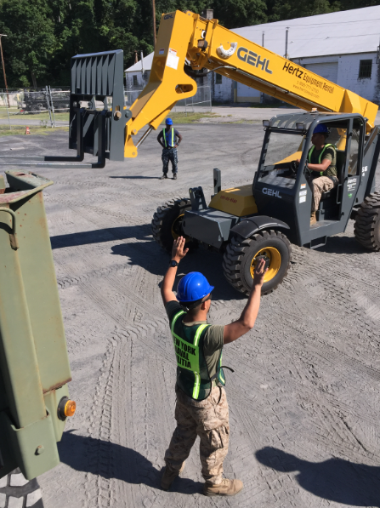
Operator training and certification
Training program requirements
  Formal training
  Practical training
  Evaluation
Operator certification
  Name, training and evaluation date(s), trainer(s) identity
Building 70 Forklift Training by Mcknighd is licensed under CC BY-SA 4.0
Notes:
For today, I want to highlight forklift training requirements.
Occupational Safety and Health Administration (OSHA) 29 CFR 1910.178 standard requires that the employer shall ensure that each forklift operator is competent to operate a forklift safely, as demonstrated by the successful completion of the training and evaluation. This requirement includes the following:
1. Formal training – lecture, discussion, interactive computer learning, written materials, videos
2. Practical training – demonstrations performed by the trainer and practical exercises performed by the trainee
3. Evaluation of the trainee’s performance in the workplace
All operator training and evaluation shall be conducted by persons who have the knowledge, training, and experience to train forklift operators and evaluate their competence.
The employer shall certify that each operator has been trained and evaluated. The certification shall include the name of the operator, the date of the training, the date of the evaluation, and the identity of the person(s) performing the training or evaluation.

Slide 35
BWC Safety Services
Contact a BWC industrial safety consultant specialist to assist you with your forklift program or to improve forklift safety in your facility.
Attend BWC’s Powered industrial trucks: Developing a training program half-day workshop in-person.
Access BWC’s powered industrial trucks and other mobile equipment online e-course.
Contact the BWC library for access to streaming videos that include forklift safety.
Notes:
BWC offers expert on-site consultations to assist you with the development of your forklift training program or review your current program. They also can assess and make recommendations to improve forklift safety at your facility.
BWC offers a variety of training courses in multiple formats to help you find the information you need in a format that fits your schedule. We offer in-person training, virtual training classes, online courses, webinars, and blended learning.
The BWC Library provides access to Streamery, a streaming video platform with a wide range of safety and human resource topics. With 24-hour access, Streamery gives you the freedom and flexibility to watch videos at your convenience.

Slide 36

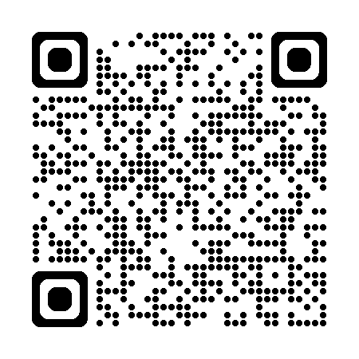
Office of Safety Services – we are here to help
On-site safety consultations
Workplace hazard assessments
Ergonomics and process safety reviews
Industrial hygiene testing
Training and education courses
Grant opportunities for safety equipment
Notes:
*Required Slide*
As always, please remind those in attendance of the services offered by the Office of Safety Services.

Slide 37
Notes:
*REQUIRED SLIDE*

Slide 38
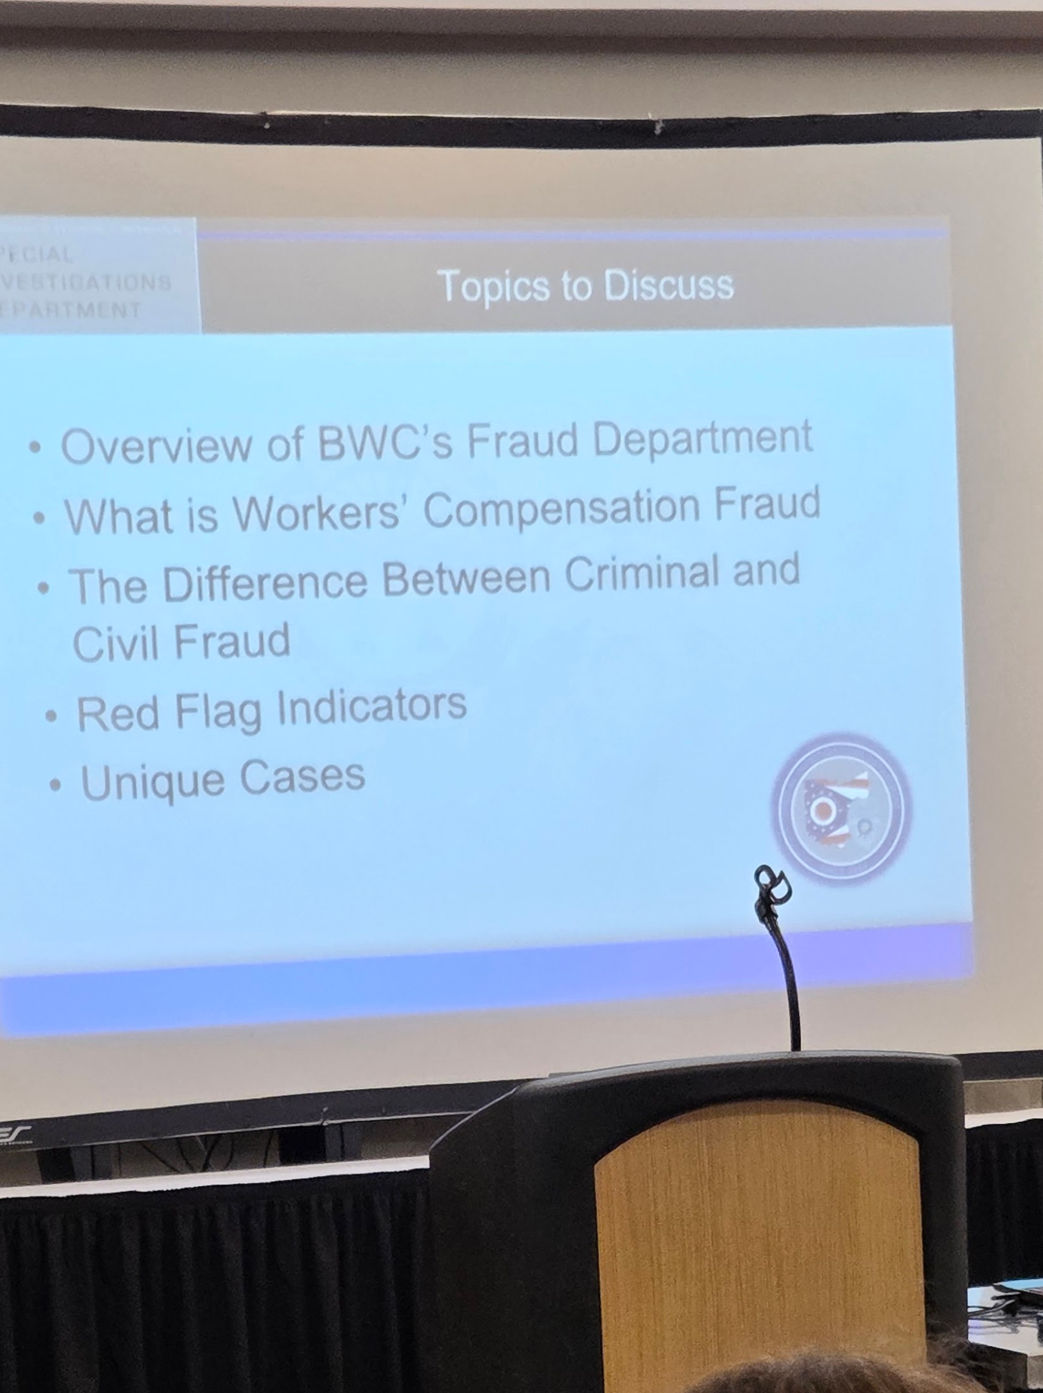
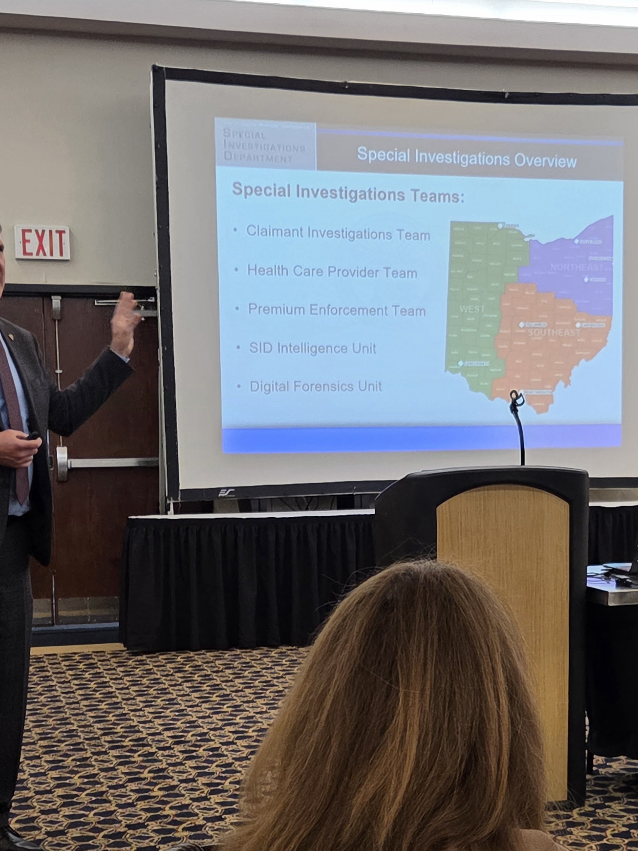
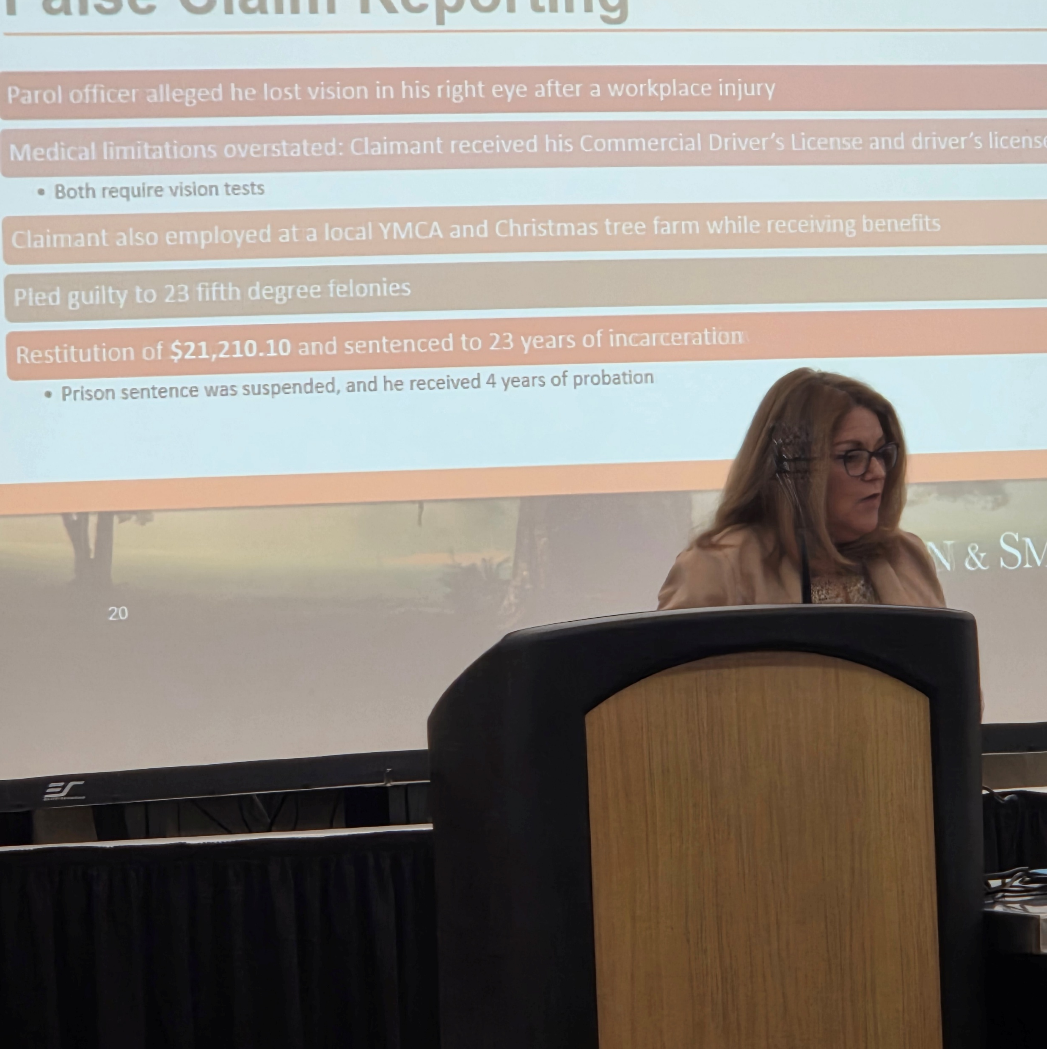
PICTURES FROM THE MEETING – NO SLIDES TO SHARE
Shawn Fox
Special Investigations Overview
Eastman & Smith-Program Sponsor
Kim Kondalski
Overview of BWC’s Fraud Department

Slide 39

THANKS FOR BEING HERE TODAY 50/50 DRAWING -
GOOD LUCK!
VOLUNTEER OPPORTUNITY4/20 – LET DEB KNOW

Slide 40
THANKS FOR ATTENDING
THE NEXT MEETING IS ON MAY 13, 2026
ON A WEDNESDAY INSTEAD OF A TUESDAY
UNTIL THEN….
BE SAFE OUT THERE! ☺

