Slide 1





WELCOME EVERYONE
West Central Ohio Safety Council
june Monthly Meeting

Slide 2

TODAY’S AGENDA
8:00 am: Meeting Begins with Announcements
Deb – SC updates and External Training Opportunities
BWC Updates from Butch Blankenship
Keynote Speaker Presentation – Brian Brianhorst, Operations Manager at the Lima YMCA
THANK YOU! Volunteers at the Fairground!
Meeting Wrap-Up - Pull 50/50 Winning Number
Meeting Adjourned by 9 am
***SLIDES WILL BE SHARED WITH ATTENDEES AFTER THE MEETING AS WELL AS THE ATTENDANCE

Slide 3

THANK YOU TO EVERYONE
WHO VOLUNTEERED LAST WEEK!

Slide 4
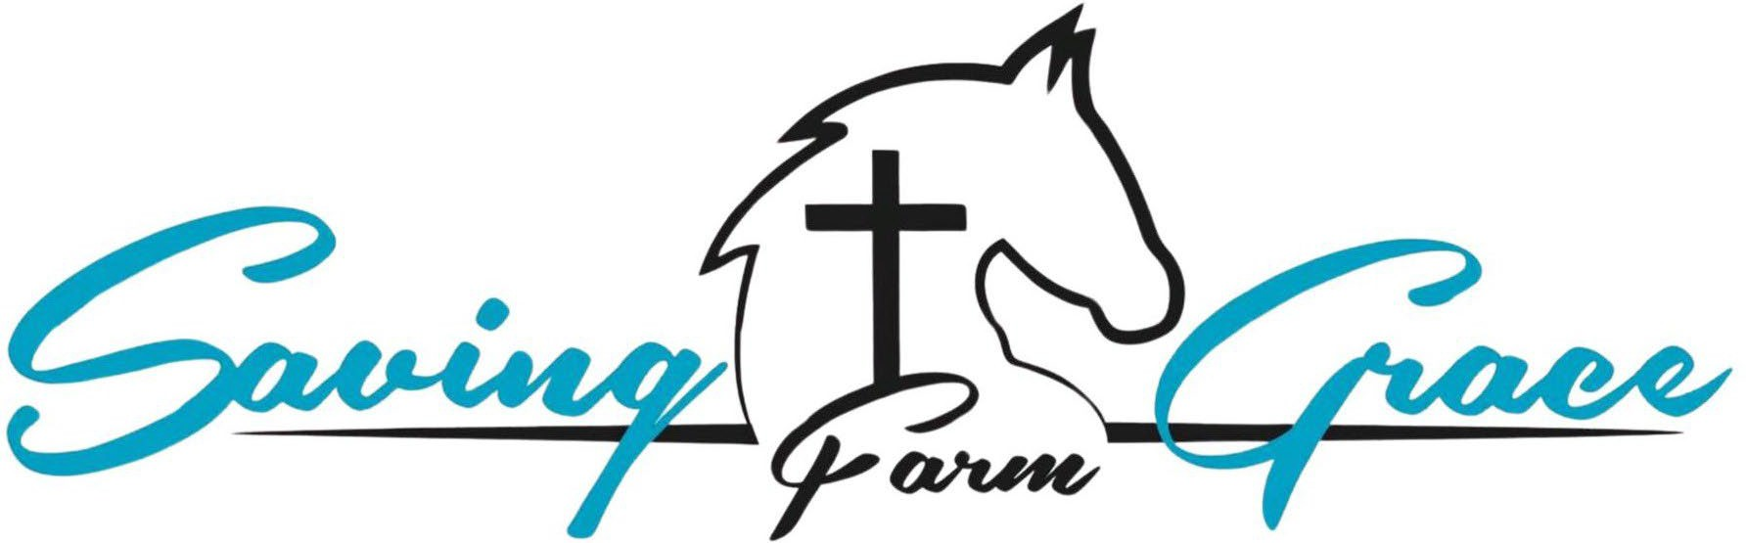

FY2026 CHARITIES
SAVING GRACE FARM MINISTRIES
ALLEN LIMA LEADERSHIP’S TEDDY BEAR FUND
The Mission of Saving Grace Farm Ministries is to provide an atmosphere for the rescue, redemption and restoration of emotionally wounded people and horses, each using the other as instruments to renew hope, rebuild trust and foster healing through the knowledge of grace found in Jesus Christ.
The Allen Lima Leadership Teddy Bear Fund is a charitable initiative aimed at supporting children in need within the community. By providing teddy bears and other comforting items, the fund seeks to offer emotional support and a sense of security to children facing challenging circumstances, such as illness or family hardships.
3

Slide 5

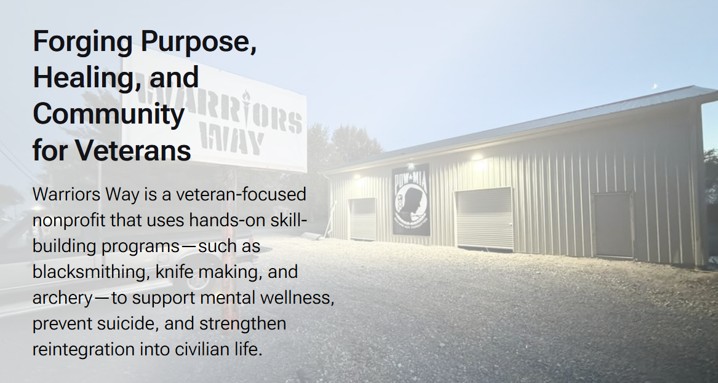
FY2027 CHARITIES
Warrior’s Way

Slide 6
BUY YOUR 50/50 RAFFLE TICKETS NOW
For Sale at the registration table Now accepting Venmo
6 tickets for $5
1 ticket for $1

Slide 7

STEERING COMMITTEE MEMBERS
President: Amy Ricker, Lima Pallet Co. | Joe Hutton, Fort Amanda Specialties
Vice President: Crystal Jackson, Cenovus- Husky Lima Refinery | Tony Daley, Spallinger Millwright
Past President: Craig Hohenbrink, INEOS | Deb Katzenmeyer, Director
Josh Unterbrink, Chamber Liaison

Slide 8




ATTENDANCE
Safety resources matter — presentation slides will be emailed following today’s meeting.
Need external safety credits? Booklets are available at the registration table, along with learning flyers from BWC.
Stay compliant — please review and verify your attendance throughout the year to ensure accurate safety records.

Slide 9

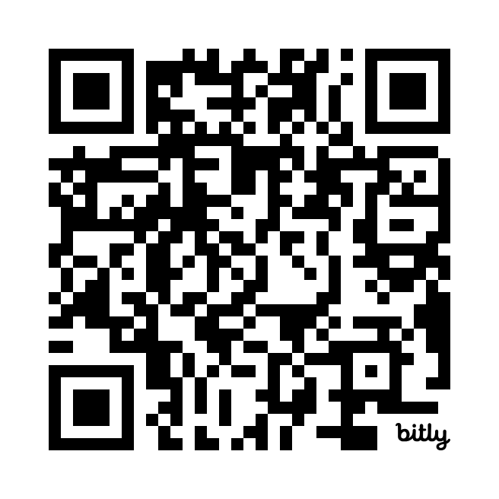
Check attendance - Scan QR Code
CLICK HERE TO VIEW ATTENDANCE Through June 9th
Please look this over ASAP and reach out with
any discrepancies for me to review.

Slide 10
FY 2026 SCHEDULE
STAY TUNED FOR FY27 PROGRAMMING
7

Slide 11


Drug Free Safety Program - 2026
Drug Free Safety Training
October 14, 2026
Sheakley Trainer
Invitations will be emailed out

Slide 12
Safety Council Update
Kimberly S. Kondalski, Esq.
June 2026

Slide 13
An introduction to:
Non-at-Fault Motor Vehicle Accident Claims
(“No-Fault MVAs”)

Slide 14

For Accidents Occurring on or After July 1, 2017:
Eligible employers can apply to the BWC to exclude the cost of the claim from their rating experience if certain requirements are met.

Slide 15
Eligible Employers
The employer must be a private or public state-funded employer and must meet the following criteria:
Have active BWC workers’ compensation coverage on the date of injury;
Be current on all payments due to BWC; and
Be current on any part-pay agreement.

Slide 16
Application Process
Employers must file a Request to Charge the Surplus Fund for Non-At Fault Motor Vehicle Accident (AC-28)
Application must include proof of:
A motor vehicle accident involving a third-party who caused the claim
The third-party involved was issued a citation
In absence of a citation, proof that the third-party was primarily liable for the accident
The third-party has valid insurance, or the employer’s auto policy covers the claim under the uninsured or underinsured motorist coverage, and the insurer has accepted the claim

Slide 17
QUESTIONS?????
Thank You!
Kim Kondalski, Esq.
Eastman & Smith Ltd.
(419) 247-1667

Slide 18
Opening slide – BWC logo

Slide 19
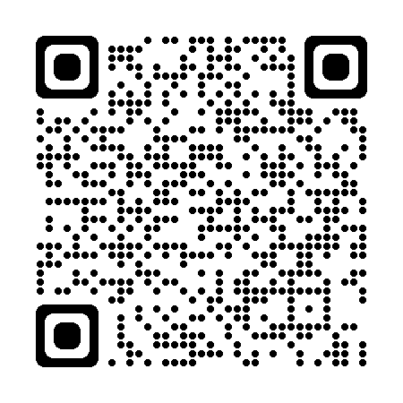
June Safety Council Update
West Central Ohio Safety Council
Butch Blankenship
Industrial Safety Consultant Specialist
Toledo Service Office
419-461-4760
butch.b.2@bwc.ohio.gov
bwc.ohio.gov

Slide 20
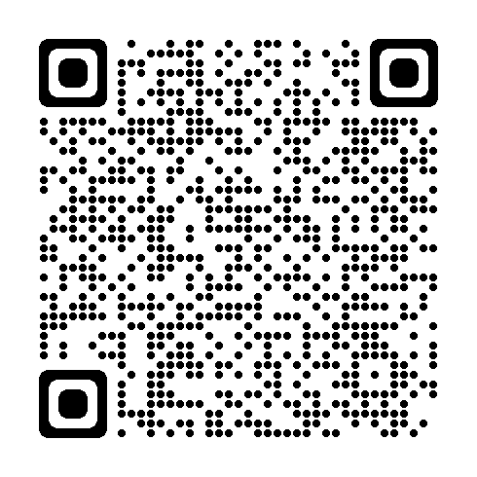

Monthly Learning June
June 2 - First aid in the workplace
Del-Co Water Co. Wolf Event Center 201, Delaware, OH
June 9 - Violence in the workplace
Bowling Green State University, Perrysburg, OH
  June 9 - Ergonomics: Basic principles
  Del-Co Water Co. Wolf Event Center 201,
  Delaware, OH
June 16 - Electrical basics
Edison State Community College, Piqua, OH
  June 18 - First aid in the workplace
  Canton Service Office
bwclearningcenter.com
In-person classes and virtual training classes (VTC) qualify for Safety Council rebate external training credits.
Notes:
*Required slide

Slide 21
Webinars – June and July
June 4 - Working in a confined space? What you should know before you break the plane
July – No webinars scheduled for July
bwclearningcenter.com
Webinars do not qualify for Safety Council rebate external training credits.
Notes:
*Required slide
No scheduled webinars in July.

Slide 22
Private Employer Important Dates – June and July
June 1 - PA last day for individual retro settlements (close out year for 10-year annual evaluation)
June 22 - PA PY 2026 first installment due
July 1 - PA policy year begins
July 1 - PA Early Payment Discount due date, employer must pay the full PY 2026 estimated annual premium
Notes:
*Required slide

Slide 23
Private employer important dates – June and July – (continued)
July 1 - PA Payroll true-up period for policy year 2025 begins
July 15 - PA deadline to file settlement application (C-240) to impact EM
July 31 - PA .99 EM Construction Cap deadline to opt out (U-108) or submit Safety Management Self-Assessment (SH-26)
July 31 - PA Substance Use Prevention and Recovery (SUPR) Program, BWC recommends the accident analysis training for the initial program year be completed by this date. New supervisors must complete within 60 days of becoming a supervisor
Notes:
*Required slide

Slide 24
Public Employer Important Dates – June and July
June - No important public employer deadline dates
July 31 - PEC Deductible Program application deadline for 1/1/2027 start date
July 31 - PEC Group Retrospective application deadline for 1/1/2027 start date
July 31 - PEC Claim Impact Reduction Program (CIRP) application deadline for 1/1/2027 start date (initial year applicants)
July 31 - PEC Retrospective Rating application deadline for 1/1/2027 start date
Notes:
*Required slide
No specific public employer deadline dates to mention.

Slide 25
Electrical Safety Basics Overview
Electrical risks exist even at low voltage
Common injuries include shocks, burns, and falls
Most fatalities occur in non-electrical jobs ( 140-150 deaths in 2023)
Water and metal increase risk
Proper training and awareness are critical
Provide the right equipment and PPE
Notes:
* Optional slide
Here are your objectives for today’s discussion.
Even Low voltage can have significant injuries.
Electrical burns are very damaging to the nerves, and muscles
Data compiled by the Electrical Safety Foundation International show that a large majority of electrical fatalities happen to workers in occupations that are not classified as electrical trades, so “most electrical fatalities occur in non‑electrical jobs” is supported by recent analyses. The Census of Fatal Occupational Injuries counted about 140–150 electrical exposure deaths in 2023.
Water and metal both increase electrical‑shock risk because water lowers skin and surface resistance, and metal provides a low‑resistance path to ground; together they greatly raise the chance that an energized source will produce a harmful current through a person.
Electrical training and properly PPE are essential — training prevents unsafe work practices and PPE reduces injury severity., together they are core requirements of effective guidance for protecting workers from shock, arc flash, and burns.

Slide 26
OSHA Data 2011-2023
Contact with or exposure to electricity continues to be one of the leading causes of workplace fatalities and injuries
1,940 workplace electrical fatalities between 2011 – 2023
5.6% of all workplace fatalities are caused by electricity
74% of fatalities occur in non-electrical occupations
Notes:
* Optional slide
OSHA Data released 2024
https://www.esfi.org/workplace-safety/workplace-injury-fatality-statistics/
The Data underscores the need for better training, awareness, and safety protocols—not just for electricians, but for everyone who might encounter electrical systems.
It also suggests that many of these deaths could be prevented with proper lockout/tagout procedures, PPE, and hazard recognition.

Slide 27
Types of Electrical Hazards
  Severity and effects of an electrical shock depend on a number of factors
    Pathway through the body
    Amount of current
    Length of time of the exposure
    Whether skin is wet or dry
  Water
    Great conductor
    Allows current to flow more easily in wet conditions and through wet skin
Notes:
* Optional slide
The severity and effects of an electrical shock depend on several factors, such as the pathway through the body, the amount of current, the length of time of the exposure, and whether the skin is wet or dry.
Water is a great conductor of electricity, allowing current to flow more easily in wet conditions and through wet skin.

Slide 28
Electrical Injuries
There are four main types of electrical injuries:
  Direct:
    Electrocution (death due to electrical shock)
    Electrical shock
    Burns
  Indirect:
    Falls
Notes:
* Optional slide
When an electrical shock enters the body, it may produce different types of injuries.
Electrocution results in internal and external injury to body parts or the entire body – often resulting in death.
Shock or a “jolt” of electricity in part of the body may be temporarily paralyzed, may cause loss of grip or stability.
A person may also involuntarily move because of receiving an electrical shock, resulting in a fall.
Internal or external burns may result from contact with electricity.

Slide 29
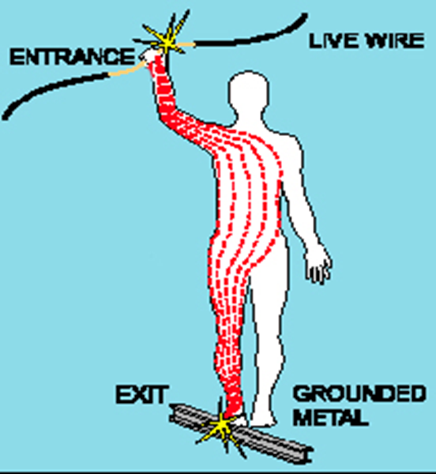
Shock Severity
Severity of the shock depends on:
Path of current through the body
Amount of current flowing through the body (amps)
Duration of the shocking current through the body
LOW VOLTAGE DOES NOT MEAN LOW HAZARD
Image courtesy of OSHA
Notes:
* Optional slide
Other factors that may affect the severity of the shock are:
- The voltage of the current.
- The presence of moisture
- The general health of the person prior to the shock.
Low voltages can be extremely dangerous because: Path across heart, Duration/exposure, falls from ladders
The resistance of the body varies based on:
The amount of moisture on the skin (less moisture = more resistance)
The size of the area of contact (smaller area = more resistance)
The pressure applied to the contact point (less pressure = more resistance)
Muscular structure (less muscle = less resistance)

Slide 30
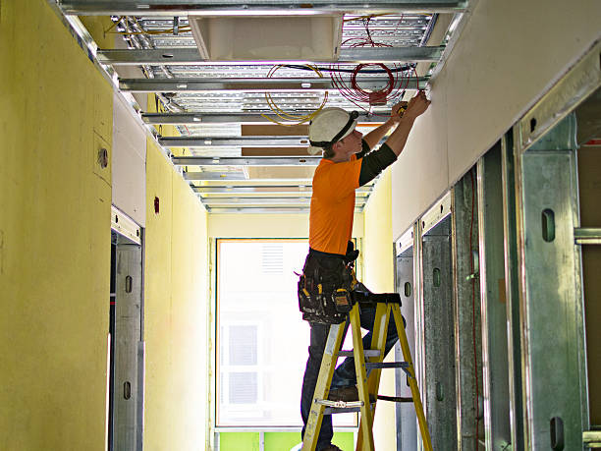
Falls
Electric shock can also cause indirect injuries
Workers in elevated locations who experience a shock may fall, resulting in serious injury or death
Source: NIOSH
Notes:
* Optional slide
Picture from NIOSH Electrical Safety Manual.
What is conductive in the picture? Wires, conduit, aluminum frame for drop ceiling. Ladder is fiberglass and not conductive.
If worker touches hot wire and any conductive surface, they will likely receive a shock. The shock may cause them to fall.

Slide 31
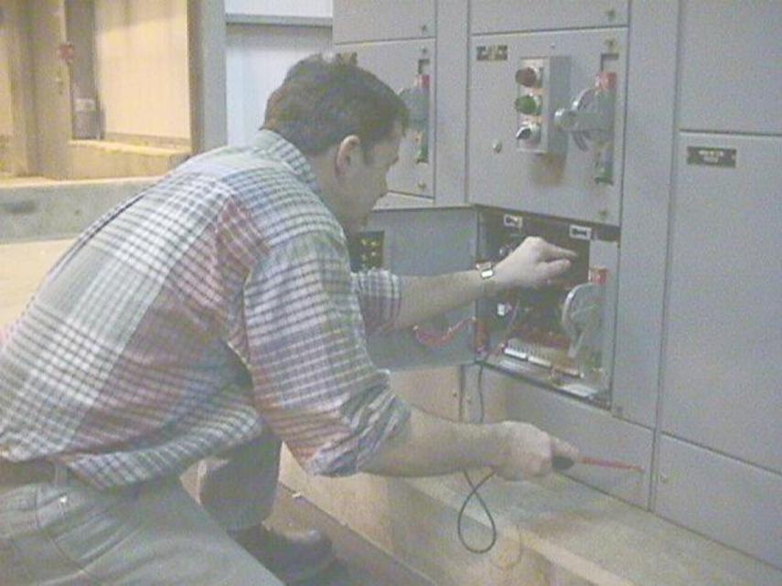
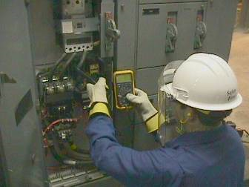
Safeguards for Personnel Protection: Personal Protective Equipment
Employer shall provide PPE appropriate for the magnitude and specific body parts for the exposure
Protective equipment shall be maintained in a safe, reliable condition and shall be periodically inspected or tested
Photographs courtesy of OSHA
Notes:
* Optional slide
Employees working in areas with the potential for electrical hazard exposure shall be provided appropriate PPE.
PPE required shall be determined prior to the task....ideally thru a Job Hazard Assessment or a pre-task evaluation.
OSHA 1910.335- Protective equipment shall be maintained in a safe, reliable condition and shall be periodically inspected or tested

Slide 32
Training Requirements
Employees (qualified and unqualified) shall be trained in and familiar with the electrical safety work practices that pertain to their job assignments
The degree of training shall be determined by the risk to the employees
Training shall be of the classroom or on-the-job type
Notes:
* Optional slide
Qualified persons (e.g., electricians)
Unqualified persons (e.g., maintenance workers, machine operators) who may still be exposed to electrical hazards
Employees shall be trained in the safety related work practices that pertain to their job assignments; which means that the content of training for office workers would differ from the training to a machine operator.
Even though annual training is not explicitly required by OSHA, many employers choose to conduct it annually to:
Reinforce safety culture
Stay compliant with NFPA 70E (which recommends refresher training every 3 years)
Address changes in equipment or procedures.
Employee’s job duties change.
New equipment or hazards are introduced.
There is evidence that the employee has not retained the necessary knowledge or skills.

Slide 33

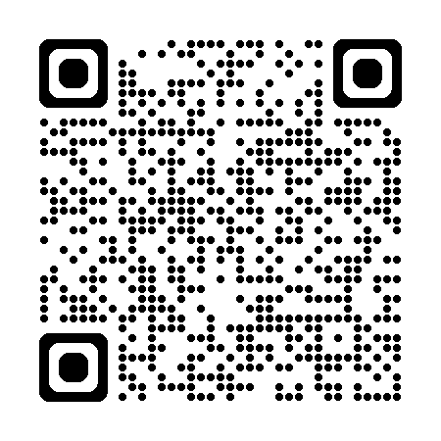
Office of safety services – We are here to help
On-site safety consultations
Workplace hazard assessments
Ergonomics and process safety reviews
Training and education courses
Grant opportunities for safety
equipment
Notes:
*Required slide – Always end slide show with call to action with OSS service offerings.

Slide 34
Closing slide – BWC logo

Slide 35
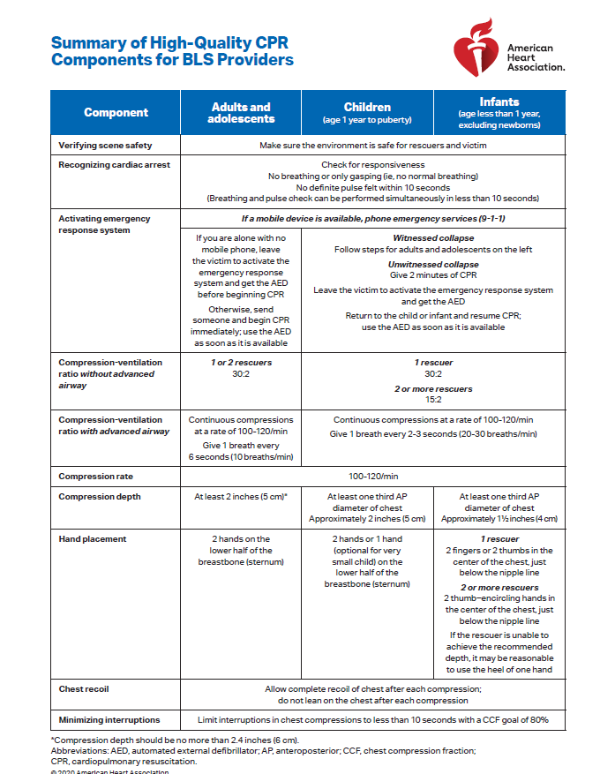

Slide 36

THANKS FOR BEING HERE TODAY
50/50 DRAWING

Slide 37
CHARITY SUBMISSIONS FOR FY 2027
Warriors Way is on the list.
If you have any other group that you’d like to toss in the mix, please email Deb ASAP!

Slide 38
THANKS FOR ATTENDING
THE NEXT MEETING IS ON JULY 14, 2026
Our FIRST meeting for FY27.
UNTIL THEN….
BE SAFE OUT THERE! ☺

Slide 39


Slide 40
