Slide 1





WELCOME EVERYONE
West Central Ohio Safety Council
MAY Monthly Meeting

Slide 2

TODAY’S AGENDA
8:00 am: Meeting Begins with Announcements
Deb – SC updates and External Training Opportunities
Julie Klingler, Director of Programs and Partnerships at the Chamber
BWC Updates from Butch Blankenship *Deb is playing Butch this month
Keynote Speaker Presentation - Nicholas Coia, COO, CS² Safety
Volunteer for June 4th at Allen County Fairgrounds
Meeting Wrap-Up - Pull 50/50 Winning Number
Meeting Adjourned by 9 am
***SLIDES WILL BE SHARED WITH ATTENDEES AFTER THE MEETING AS WELL AS THE ATTENDANCE

Slide 3

Volunteer Opportunity
West Central Ohio Safety Council is promoting a day at the Allen County Fairground helping the West Ohio Food Bank
June 4th, 9:30 – 1:30
Shift 1: Help at Resource Fair: 9:00-11:00
Shift 2: Food Distribution: 11:30-2:00pm
or BOTH
If you are interested, let me know ASAP.

Slide 4
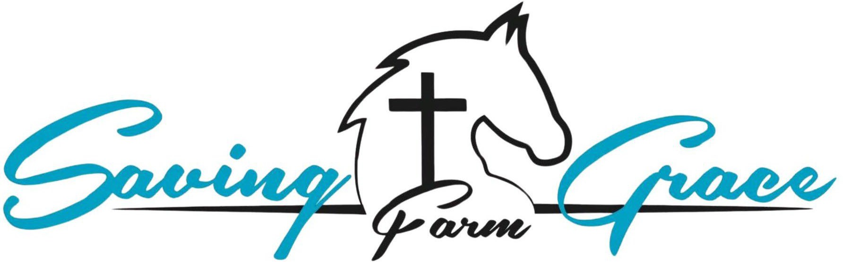
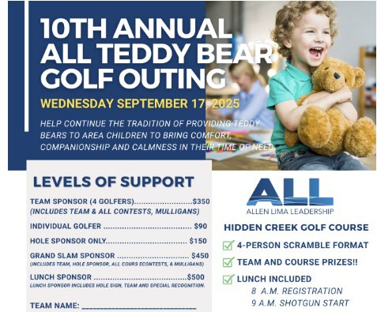
FY2026 CHARITIES
SAVING GRACE FARM MINISTRIES
ALLEN LIMA LEADERSHIP’S TEDDY BEAR FUND
The Mission of Saving Grace Farm Ministries is to provide an atmosphere for the rescue, redemption and restoration of emotionally wounded people and horses, each using the other as instruments to renew hope, rebuild trust and foster healing through the knowledge of grace found in Jesus Christ.
The Allen Lima Leadership Teddy Bear Fund is a charitable initiative aimed at supporting children in need within the community. By providing teddy bears and other comforting items, the fund seeks to offer emotional support and a sense of security to children facing challenging circumstances, such as illness or family hardships.
3

Slide 5
BUY YOUR 50/50 RAFFLE TICKETS NOW
For Sale at the registration table Now accepting Venmo
6 tickets for $5
1 ticket for $1

Slide 6

STEERING COMMITTEE MEMBERS
President: Amy Ricker, Lima Pallet Co. | Joe Hutton, Fort Amanda Specialties
Vice President: Crystal Jackson, Cenovus- Husky Lima Refinery | Tony Daley, Spallinger Millwright
Past President: Craig Hohenbrink, INEOS | Deb Katzenmeyer, Director
Josh Unterbrink, Chamber Liaison

Slide 7

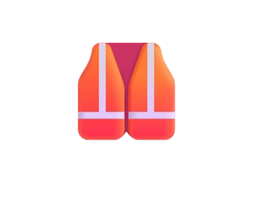


ATTENDANCE
Safety resources matter — presentation slides will be emailed following today’s meeting.
Need external safety credits? Booklets are available at the registration table, along with learning flyers from BWC.
Stay compliant — please review and verify your attendance throughout the year to ensure accurate safety records.

Slide 8

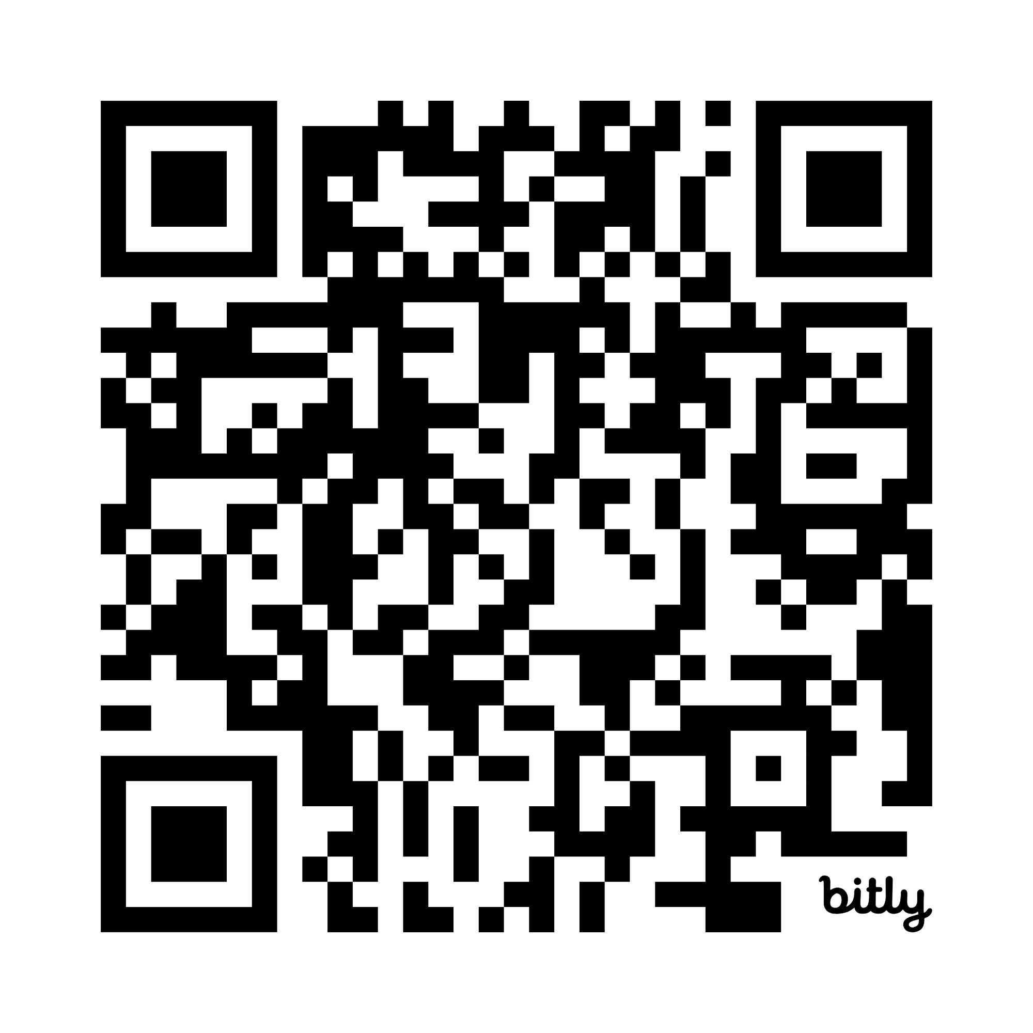
Check attendance - Scan QR Code
Through Today -
There is a printed attendance sheet
at the registration table
Verify your attendance
throughout the year

Slide 9
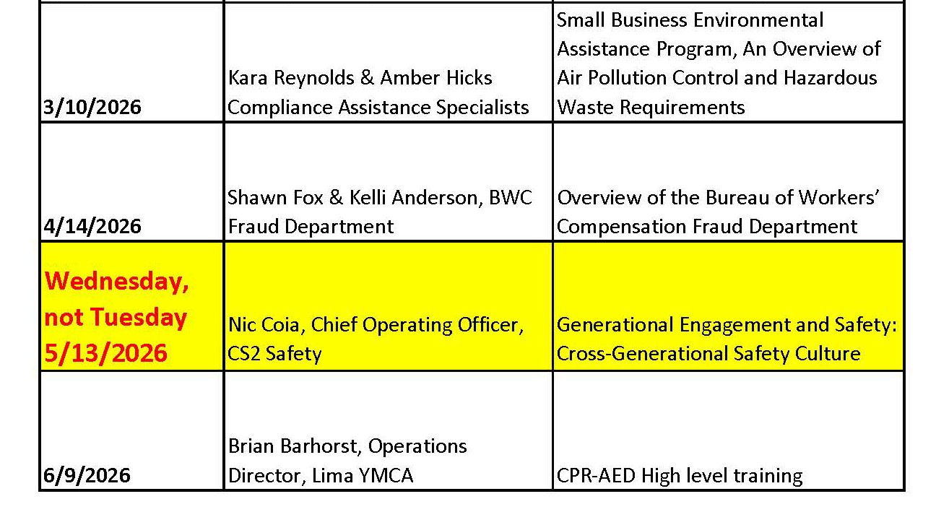
FY 2026 SCHEDULE
STAY TUNED FOR FY27 PROGRAMMING
7

Slide 10

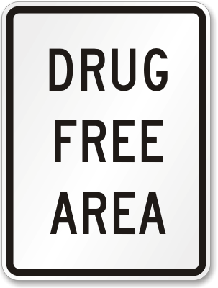
Drug Free Safety Program - 2026
Drug Free Safety Training
October 14, 2026
Sheakley Trainer
Invitations will be emailed out

Slide 11
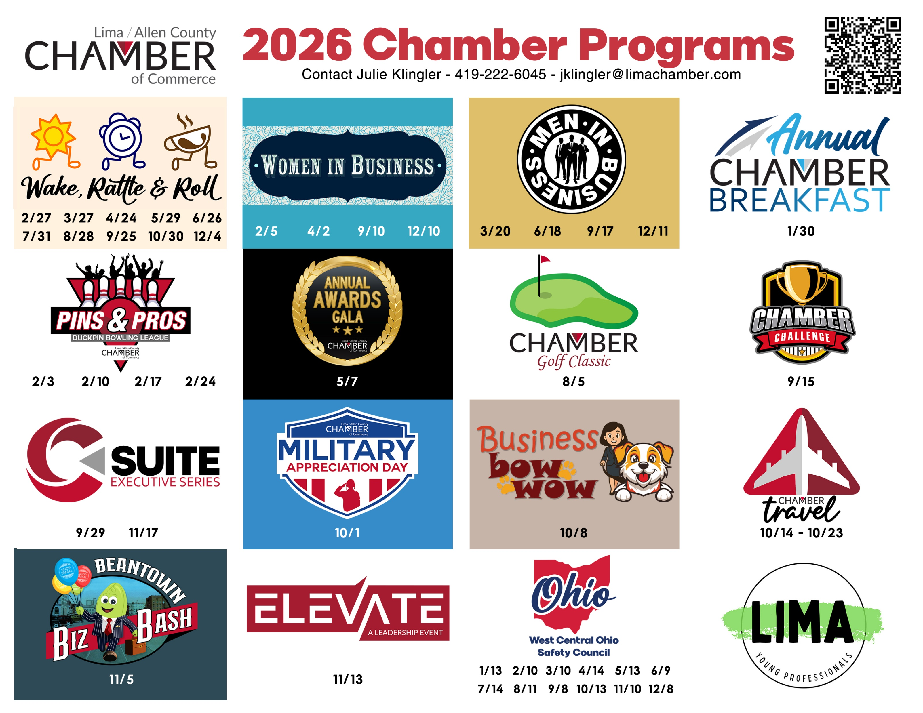

Slide 12
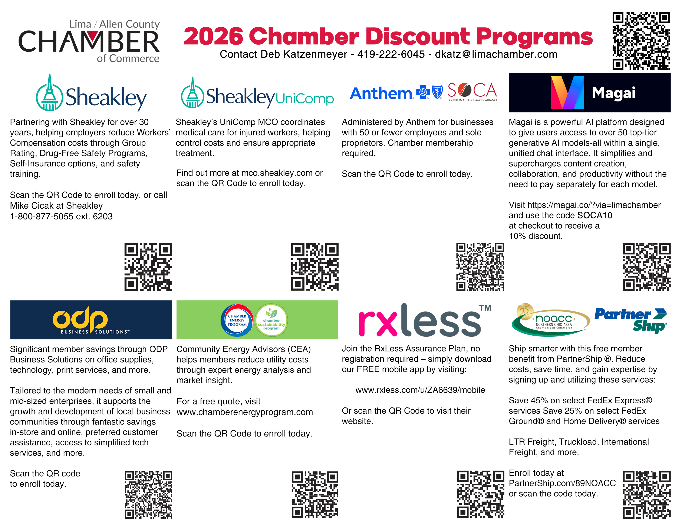

Slide 13
Closing slide – BWC logo
CLICK HERE TO ACCESS BWC SLIDES

Slide 14
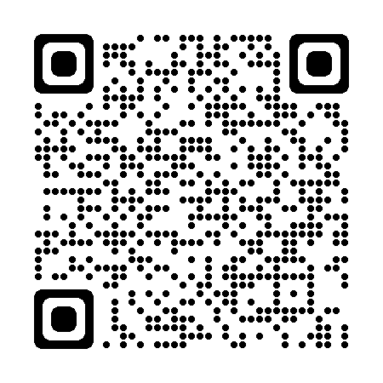
May Safety Council Update
West Central Ohio Safety Council
Butch Blankenship
bwc.ohio.gov
Industrial Safety Consultant
Toledo Service Office
419-461-4760
butch.b.2@bwc.ohio.gov
Notes:
*REQUIRED SLIDE*
QR Code takes you to BWC website.

Slide 15
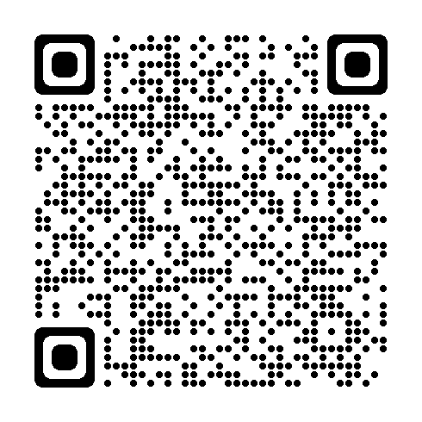

Monthly learning May
May 14 - Emergency preparedness planning half-day workshop
Cincinnati/Springdale Service Office
May 19 - Crisis de-escalation tactics and safe practices
Canton Service Office
  May 20-21 - OSHA 10: Industry safety basics
  Bowling Green State University, Perrysburg, OH
May 21 - First aid in the workplace
Edison State Community College, Piqua, OH
May 21 - Combustible dust hazards: Recognition, evaluation and control recommendations
Indiana Wesleyan University, Independence, OH
  May 28 - Safety for the non-safety professional
  Canton Service Office
bwclearningcenter.com
In-person classes and virtual
training classes (VTC) qualify for Safety Council rebate external training credits.

Slide 16

Monthly learning June
June 2 - First aid in the workplace
Del-Co Water Co. Wolf Event Center 201, Delaware, OH
June 9 - Violence in the workplace
Bowling Green State University, Perrysburg, OH
  June 9 - Ergonomics: Basic principles
  Del-Co Water Co. Wolf Event Center 201,
  Delaware, OH
June 16 - Electrical basics
Edison State Community College, Piqua, OH
June 17 - Safety for the non-safety professional
Bowling Green State University, Perrysburg, OH
  June 18 - First aid in the workplace
  Canton Service Office
bwclearningcenter.com
In-person classes and virtual
training classes (VTC) qualify for Safety Council rebate external training credits.

Slide 17
Virtual learning May/June
May 20 - Job safety analysis
May 28 - Safety series workshop module 6: Machine guarding basics and powered equipment basics
June 3-4 - Electrical safety in the workplace through insight and implementation of NFPA 70E
June 10 - Emergency preparedness planning half-day workshop
June 17 - Bloodborne pathogens
June 30 - Lockout/tagout and safety-related work practices
bwclearningcenter.com
In-person classes and virtual training classes (VTC) qualify for Safety Council rebate external training credits.

Slide 18
Webinars – May and June
May - No webinars
June 4 - Working in a confined space? What you should know before you break the plane
bwclearningcenter.com
Webinars do not qualify for Safety Council rebate external training credits.

Slide 19
Private employer important dates – May and June
May 1 - PA PY 2026 notice of estimated annual premium sent (approximate date)
May 15 - PA last date employer can change installment plan for PY 2026
May 29 - PA Risk Management Essentials application deadline for 7/1/2026 start date
June 1 - PA last day for individual retro settlements (close out year for 10-year annual evaluation)
June 22 - PA PY 2026 first installment due
Notes:
The Risk Management Essentials application deadline is the same for PA and PEC employers is May 29.

Slide 20
Public employer important dates – May and June
May 29 - PEC Risk Management Essentials application deadline for 7/1/2026 start date
May 29 - PEC Group experience rating application deadline for 1/1/2027 start date (must be filed by COB)
June - No important public employer deadline dates
Notes:
The Risk Management Essentials application deadline is the same for PA and PEC employers is May 29.

Slide 21
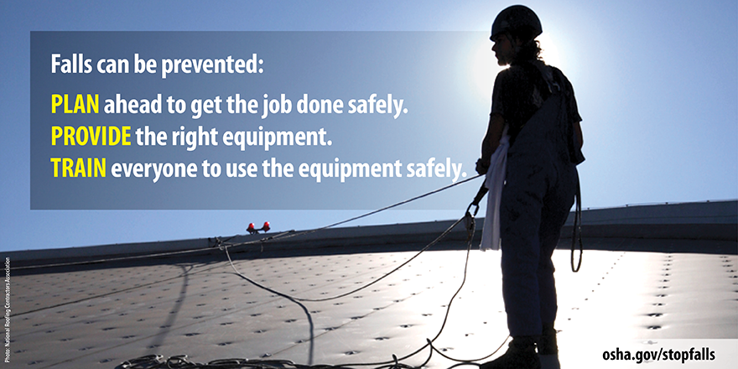
Fall prevention stand-down
Notes:
The 2026 OSHA Fall Stand-Down is scheduled to take place from May 4-8, 2026. This event is an excellent opportunity for employers and employees to focus on fall hazard awareness and prevention.
Any workplace can participate.
OSHA requires employers to evaluate and protect employees from falls from heights and walking working surfaces.
You may already know, OSHA requires fall protection at 6 feet for the construction industry and at 4 feet in height for general industry.
Photo source: OSHA's Fall Prevention Campaign - Social Media Graphics | OSHA.gov | Occupational Safety and Health Administration

Slide 22
What is a fall stand-down
It’s a voluntary event for employers and organizations to talk directly to employees and participants about safety.
It should provide an opportunity for open discussion about hazards, protective methods, and the company's safety policies, goals and expectations.
Notes:
A "Fall Stand-Down" is a voluntary event organized by employers to take time out of the day to talk directly to employees about fall hazards and fall prevention. The goal is to raise awareness about fall hazards and reinforce the importance of using proper safety measures to prevent falls in the workplace.
It's an opportunity for everyone to pause work and focus on safety. The 2026 OSHA Fall Stand-Down is scheduled to take place from May 4-8, 2026. This annual event is an excellent opportunity for employers and employees to focus on fall hazard awareness and prevention.
This event is often used in the construction industry, but any workplace can participate.
During a Fall Stand-Down, employers might conduct toolbox talks, safety equipment inspections, discuss job-specific hazards, conduct vendor demonstrations or have a motivational speaker.
Key points about a Fall Stand Down:
It is usually a brief, dedicated session focused on fall hazards and protective measures.
Common topics include ladder safety, harness inspections, working at heights, and proper use of fall‑protection systems.
OSHA promotes a National Safety Stand‑Down each year, but companies can hold their own at any time.
The goal is awareness, training, and reducing injuries by reinforcing safe practices.

Slide 23
Fall protection stand-down origin
Since 2012, OSHA has partnered with employers to focus on fall prevention.
Goal: Raise awareness about common fall hazards in construction and general industry.
Notes:
The initiative was created to raise awareness about fall hazards in the construction industry and to promote fall prevention measures. Since then, it has grown into a nationwide campaign, with millions of workers participating each year through various activities like trainings, equipment inspections, and toolbox talks.
The Stand-Down has been successful in bringing attention to the importance of fall protection and has helped reduce fall-related injuries and fatalities in the construction industry.
Employers are encouraged to plan a stand-down that works best for their workplace anytime.

Slide 24
How do I conduct a safety stand-down
Conduct a safety stand-down by taking a break during the workday to have a toolbox talk or another safety activity.
Start planning early:
  Designate individual(s) that will coordinate and organize the stand-down.
  Keep it simple – it does not need to be complicated.
Notes:
A stand-down could be as simple as a 15-minute safety talk to detailed safety equipment inspections. All workers should be invited to participate.
Employers can conduct a Fall Stand-Down by taking a break to have a toolbox talk or another safety activity such as conducting safety equipment inspections, developing rescue plans, or discussing job specific hazards. Managers are encouraged to plan a stand-down that works best for their workplace anytime.
OSHA also supports actives with an Events page that are free and open to the public to help employers and employees find events in your area.
If you plan to host a free event that is open to the public, you may contact your OSHA Regional Stand-Down Coordinator.

Slide 25
How much time is needed
Start by determining date(s) and time(s).
A stand-down could be as simple as a 15-minute toolbox talk or several hours of training over a week, or the entire month.
The choice is yours:
  How much time do you want to dedicate?
  Availability of participants, number of shifts, presenters, equipment, facilities, etc.
Notes:
Start by determining date(s) & time(s). A stand-down could be as simple as a 15-minute toolbox talk or several hours of training over a week, or the entire month based on availability of participants, number of shifts, presenters, equipment, facilities, etc.
Share your stand-down on social media show the public you care about the safety of your workforce.

Slide 26
Hold your stand-down
During the event:
  Encourage active participation and open discussion.
  Be prepared with questions to get discussions going.
  Utilize hands-on training, get employees involved.
  Encourage management participation to show their commitment.
Notes:
If you plan to host a free event that is open to the public, OSHA has an event certificate you can download from their website.
BWC has several resources specific to fall protection at no additional cost to Ohio employers.

Slide 27
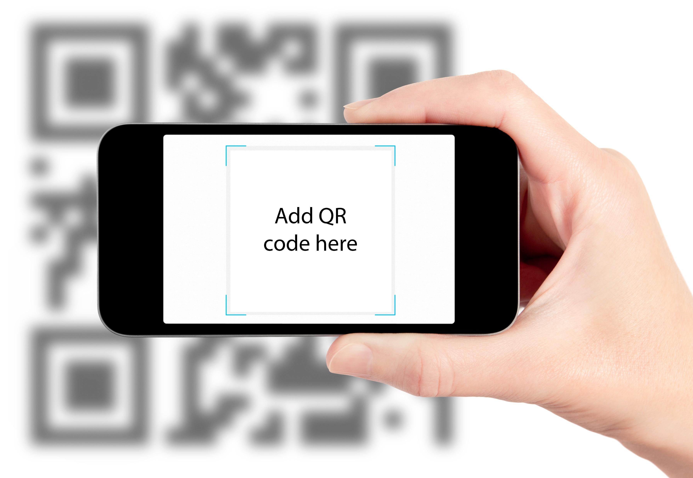
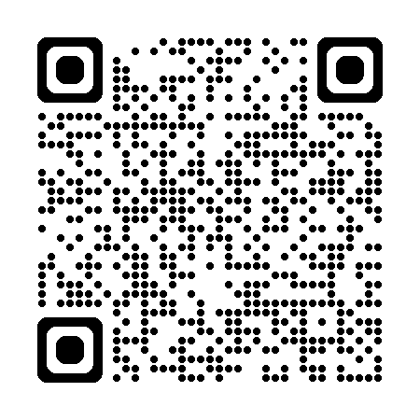
Office of safety services – We are here to help
On-site safety consultations
Workplace hazard assessments
Ergonomics and process safety reviews
Training and education courses
Grant opportunities for safety
equipment

Slide 28
Closing slide – BWC logo

Slide 29
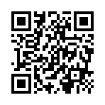
Generational Engagement and Safety: Building a Cross-Generational Safety Culture
Nicholas Coia
COO
CS² Safety
Notes:
Honor & Meeting Invite – April 1, 2026 @ 8am
Summit County Safety Council
For the first time in history, we have up to five generations working side by side. That’s 80+ years of different values, communication styles, and experiences all sharing the same space. And while that diversity is powerful, it also creates new challenges
Set the tone: this presentation is about people, not policies.
Highlight the historic nature of today’s workforce — five generations together.
Emphasize that diversity is strength if we understand and leverage it.
Frame the session goal: bridging generational gaps to build a unified safety culture
Workforces today often include four to five generations working side by side, each with unique values, communication preferences, learning styles, and attitudes toward safety. Misunderstandings or disengagement across generations can create gaps in safety culture, training effectiveness, and overall team performance.
"Generational Engagement and Safety: Building a Cross-Generational Safety Culture" is a dynamic presentation designed to help leaders, safety professionals, and employees understand generational differences and leverage them to build a stronger, unified safety culture. This session explores how each generation views workplace safety, identifies strategies to improve communication and training, and equips participants with actionable tools to foster engagement and accountability at all levels.
Through real-world examples, interactive discussion, and practical techniques, participants will learn how to bridge generational divides and cultivate a shared commitment to safety excellence. This approach not only reduces incidents but also strengthens morale, teamwork, and retention.

Slide 30
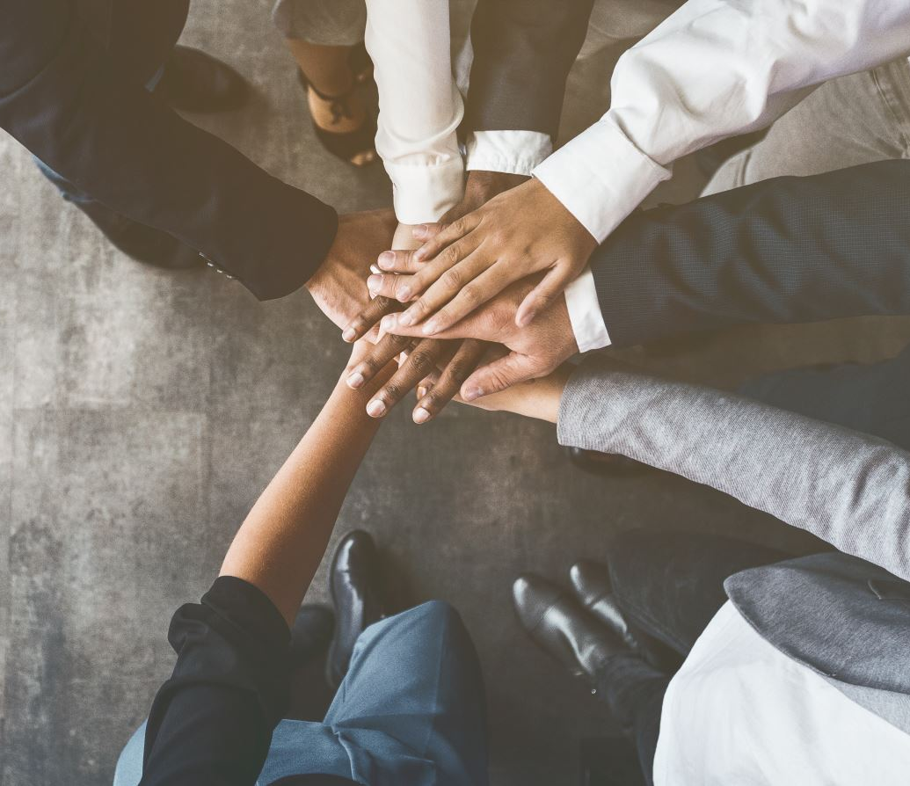
Goals
Identify generational differences and similarities
Apply leadership techniques that leverage the strengths
Implement engagement methods that inspire younger workers
Notes:
✔ Identify generational differences and similarities in attitudes toward safety, authority, and training, and understand how these impact engagement and risk tolerance.
✔ Apply leadership techniques that leverage the strengths of each generation to foster mentorship, accountability, and team cohesion.
✔ Implement engagement methods that inspire younger workers to value safety and empower experienced workers to actively mentor and share knowledge.

Slide 31
Today's Workforce Reality
For the first time ever, five generations share the same workplace:
  Traditionalists (Born ≤ 1945)
  Baby Boomers (1946 – 1964)
  Gen X (1965 – 1980)
  Millennials (1981 – 1996)
  Gen Z (1997 – 2012)
Generation Alpha (2013 – 2025) Will be here before we know it!
Notes:
Traditionalists - grew up with hierarchy and discipline.
Baby Boomers entered a rapidly industrializing world with strong work ethics and a ‘pay your dues’ mentality.
Gen X became masters of independence and skepticism.
Millennials prioritize purpose and collaboration
Gen Z, our digital natives, expect speed, feedback, and inclusion.
Explain how world events shaped their attitudes and expectations.
Emphasize that generational differences are real and influential.
Reinforce the opportunity: these differences can strengthen safety culture.

Slide 32

Why It Matters for Safety
Communication breakdowns increase risk
Disengagement reduces training impact
Mentorship gaps lose institutional knowledge
Notes:
Link generational engagement directly to incident prevention.
Discuss common failure points: communication, training, mentorship.
Share key statistics:
48% report cross-generational safety communication challenges (NIOSH).
Engaged employees are 70% less likely to have safety incidents (Gallup).
Reinforce the point: engagement isn’t a “soft skill” — it’s a risk reduction tool.
A NIOSH study found that 48% of workers say they struggle to understand safety expectations across age groups.
Gallup’s data shows engaged employees are 70% less likely to be involved in safety incidents.
Communication breakdowns between generations are one of the most common root causes of incidents I see.
Disengagement in training skyrockets when we fail to speak the language of our audience.
When experienced workers retire without mentoring, decades of safety wisdom walk out the door with them.

Slide 33
Attitudes Toward Safety by Generation
Traditionalists: Safety is discipline
Boomers: Experience keeps us safe
Gen X: Safety must make sense
Millennials: Purpose matters
Gen Z: Safety is lived and interactive
Notes:
I once saw a toolbox talk flop miserably because a Boomer supervisor lectured for 45 minutes while Gen Z workers tuned out. When we switched to shorter, story-based talks with QR codes linking to follow-ups, participation skyrocketed. Same message — different delivery.”
Traditionalists often view safety as discipline — you follow the rule because that’s how you stay alive.
Boomers trust their experience — they’ve seen enough to know what works.
Gen Xers want safety to make sense — they’ll follow the rule if it’s practical.
Millennials need the ‘why’ — they want purpose behind every policy.
Gen Z expects safety to be part of the culture, not just a rulebook.
Outline how each generation typically approaches safety.
Explain how these attitudes shape engagement and compliance.
Illustrate with the real-world toolbox talk example.
Stress the importance of adapting delivery methods to audience expectations.

Slide 34
Where Engagement Breaks Down
Cracks in communication, trust, mentorship, and motivation widen when we ignore generational differences.
Notes:
Identify common breakdown areas: communication, trust, mentorship, motivation.
Highlight that problems arise when differences are ignored, not when they exist.
Share the text-message incident story to show real-world impact.
Transition: set up the introduction of the solution — the 4-Pillar PEOPLE Model.
I’ve seen simple miscommunications turn into near misses. In one case, a Gen Z new hire texted a supervisor about a hazard — but the Gen X supervisor never checks his phone during shifts. The message was missed, and a piece of equipment was damaged. Both were trying to do the right thing — they were just speaking different ‘safety languages.’ Our job as leaders is to build bridges across those differences, not let them become cracks in the foundation.”
“Generational differences don’t automatically cause problems — but ignoring them absolutely does. Engagement starts to break down when we assume everyone thinks and communicates like we do.

Slide 35
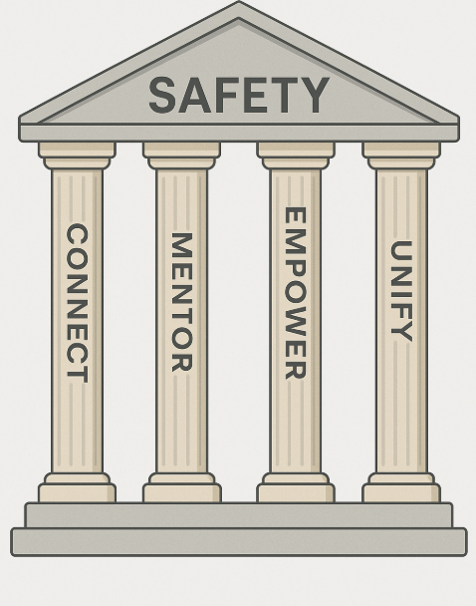
The 4-Pillar PEOPLE Model
Connect Through Communication
Mentor with Intention
Empower with Purpose
Unify Through Culture
Notes:
Introduce the custom 4-pillar model as the framework for the session.
Reiterate that safety culture is people-driven, not policy-driven.
Present the four pillars clearly and in order.
Preview that each pillar builds upon the previous one.
Now that we’ve explored the challenge, let’s talk about the solution — a people-focused approach I call the 4-Pillar PEOPLE Model.
These four pillars are built around one idea: safety isn’t just about procedures, it’s about people.
When we focus on people, we can bridge the gaps between generations and build a stronger, more engaged culture.
The four pillars are: Connect Through Communication, Mentor with Intention, Empower with Purpose, and Unify Through Culture.
When we intentionally practice all four, we transform generational differences from obstacles into opportunities.”

Slide 36
Pillar 1: Connect Through Communication
Adapt language and medium
Layer messaging: verbal, written, visual
Translate safety into generational values
Notes:
Communication is the foundation of engagement.
Adapt message format: verbal, written, visual.
Adjust tone and content to resonate with different values.
Emphasize that “one size fits all” no longer works.
Every generation speaks a different ‘language’ — not literally, but in how they process information.
If we’re still delivering safety messages the same way we did 20 years ago, we’re missing half our audience.
Communication has to be layered: verbal messages in meetings, written follow-ups for those who want details, and visual reminders for quick learners.
And it’s not just the format — it’s the tone and purpose.
A message that resonates with a Baby Boomer might fall flat with Gen Z. Our job is to translate safety into the language each generation understands.

Slide 37

Story: Communication Success
Changing weekly updates
- PDFs to 90-sec video clips
Increased engagement from 27% to 81%.
Notes:
I saw this in action at a logistics company I worked with. Their weekly safety updates were emailed as long PDFs — and younger employees never read them. Engagement sat at 27%. We helped them switch to 90-second video clips shared via text message and app notifications. Engagement shot up to 81% almost overnight. The safety message didn’t change — the delivery did. And when people actually see and hear the message in a way that fits how they communicate, it sticks.
Real-world example: logistics company case study.
Problem: traditional communication failing younger workers.
Solution: adapting format (short videos, mobile delivery).
Result: engagement increased from 27% → 81%.

Slide 38
Pillar 2: Mentor with Intention
Pair seasoned workers with new hires
Formalize mentorship
Encourage reverse mentoring
Notes:
The second pillar is Mentor with Intention. Experience has no expiration date — but it’s wasted if it’s not shared. Too often, mentorship is informal or accidental. We need to make it deliberate. Pair seasoned workers with newer employees. Create structured opportunities for storytelling, skill-sharing, and reflection. And don’t forget reverse mentoring — younger employees bring fresh perspectives and tech skills that older generations can learn from. When mentorship becomes part of your safety strategy, it builds trust and accelerates learning across generations.”
Emphasize the value of mentorship in preserving safety knowledge.
Formalize mentorship instead of relying on informal interactions.
Highlight reverse mentoring as a powerful two-way tool.
Stress that mentorship strengthens trust and accountability.

Slide 39

Story: Legacy Program Impact
A 'Safety Legacy Program' pairing retirees with new hires boosted near-miss reporting by 40%.
Notes:
One of my favorite examples of intentional mentorship came from a utilities company.
They launched a ‘Safety Legacy Program’ where retired and senior employees were invited back monthly to mentor new hires.
These sessions were just conversations — no PowerPoints, no lectures, just stories and lessons learned.
Within six months, near-miss reporting had increased by 40%.
Younger workers felt safer asking questions, and veteran workers felt valued again.
That’s what happens when you turn mentorship into a strategy instead of a suggestion.”
Case study: utilities company’s “Safety Legacy Program.”
Program design: informal storytelling mentorship sessions.
Results: 40% increase in near-miss reporting.
Key insight: mentorship builds confidence and bridges generational divides.

Slide 40
Pillar 3: Empower with Purpose
Provide the 'why,' not just the 'what'
Connect safety to personal values
Frame safety as mission-driven
Notes:
One of the biggest mistakes we make as leaders is assuming that compliance is enough. It’s not.
Compliance ≠ commitment — purpose is the bridge.
Younger generations especially need context and meaning.
Tie safety practices to values like family, community, and impact.
Empowerment shifts safety from “what we do” to “who we are.”
People don’t commit to what they don’t understand.
Especially with Millennials and Gen Z, you’ll lose engagement if you don’t explain why safety matters beyond the rule itself.
Empowerment means connecting safety tasks to their deeper purpose — protecting people’s lives, preserving their ability to go home to their families, and contributing to something bigger than themselves.
When people see safety as part of their identity, not just their job, behavior changes.”
Compliance ≠ commitment — purpose is the bridge.
Younger generations especially need context and meaning.
Tie safety practices to values like family, community, and impact.
Empowerment shifts safety from “what we do” to “who we are.”

Slide 41

Story: PPE Compliance Shift
Starting toolbox talks with 'why stories' increased PPE compliance from 72% to 95%.
Notes:
I worked with a chemical manufacturing plant that struggled with PPE compliance.
They had policies, signage, and even disciplinary measures, but compliance hovered around 72%.
We decided to change the tone of their toolbox talks. Instead of reading the PPE policy, leaders shared stories — about coworkers who’d been injured, about how PPE had saved lives, and about the impact on families.
Within three months, compliance jumped to 95%.
Same equipment. Same rules. The difference was purpose.
People were no longer following a rule — they were protecting their future.”
Case study: chemical plant PPE compliance issue.
Original approach: policy-focused, low engagement (~72%).
New approach: story-driven, purpose-centered communication.
Outcome: compliance improved to 95%.

Slide 42
Pillar 4: Unify Through Culture
Create cross-generational safety committees
Recognize contributions from all ages
Celebrate shared wins
Notes:
Culture defines behavior beyond policy.
Build inclusive safety committees representing all generations.
Recognition and shared wins strengthen unity.
Culture must be intentional — not accidental.
Policies set expectations, but culture sets behavior.
Culture is what happens when no one’s watching — and that’s where safety truly lives.
If we want a culture that bridges generations, it has to be co-created.
That means building safety committees that include every generation, recognizing contributions from everyone, and celebrating shared wins.
Culture doesn’t happen by accident — it happens by intention.
When people feel they own the culture, they stop seeing safety as someone else’s job
Culture defines behavior beyond policy.
Build inclusive safety committees representing all generations.
Recognition and shared wins strengthen unity.
Culture must be intentional — not accidental.

Slide 43

Story: Generational Safety Team
A cross-generational team redesigned safety systems, reducing incident rates by 23%.
Notes:
Real-world example: packaging facility cross-generational team.
Actions: redesigned signage, diversified communication, inclusive meetings.
Results: 23% drop in incident rates, stronger cultural ownership.
Insight: involvement drives accountability.
I saw this principle in action at a packaging facility that formed a ‘Generational Safety Team.’
They had reps from every age group — from 20-somethings to people in their 60s.
Together, they redesigned signage to make it more visual and created a mix of digital and in-person safety meetings.
Within a year, incident rates dropped by 23%.
But even more importantly, employees reported feeling more ownership over safety.
When people help build the culture, they protect it — and that’s the ultimate goal.”
Real-world example: packaging facility cross-generational team.
Actions: redesigned signage, diversified communication, inclusive meetings.
Results: 23% drop in incident rates, stronger cultural ownership.
Insight: involvement drives accountability.

Slide 44
Bringing It All Together
Connection builds trust.
Mentorship preserves knowledge.
Purpose drives engagement.
Culture sustains safety.
Notes:
Summarize all four pillars and their core outcomes:
Communication → trust
Mentorship → knowledge
Purpose → action
Culture → sustainability
Highlight synergy: the four pillars work best together.
Reinforce the idea of generational diversity as a strength.
Each of these four pillars — Connect, Mentor, Empower, and Unify — is powerful on its own.
But together, they build something far greater: a safety culture that transcends generational lines.
Communication builds trust. Mentorship preserves knowledge. Purpose inspires action. And culture sustains it all.
If we ignore generational differences, they become cracks in our foundation. But if we embrace them intentionally, they become the very beams that hold our safety culture together.
Summarize all four pillars and their core outcomes:
Communication → trust
Mentorship → knowledge
Purpose → action
Culture → sustainability
Highlight synergy: the four pillars work best together.
Reinforce the idea of generational diversity as a strength.

Slide 45
3 Leadership Actions for Tomorrow
Audit your communication methods
1
Formalize mentorship
2
Involve all generations in shaping culture
3
Notes:
Must be at least 30 Min Mark
“Let’s make this practical. I want to leave you with three actions you can start tomorrow. First, audit your communication methods. Are you reaching every generation where they are, or are you relying on a one-size-fits-all approach? Second, formalize mentorship. Don’t just hope it happens — build it into your safety system. And third, involve every generation in shaping the safety culture. Invite their voices, listen to their ideas, and empower them to lead. These steps may sound simple, but they build the foundation for a cross-generational culture that lasts.”
Audit communication: Review how you deliver safety messages — adapt for all generations.
Formalize mentorship: Make it part of your safety process, not an afterthought.
Involve all generations: Include voices of all age groups in decision-making and safety initiatives.
Reinforce that small actions today build long-term cultural change.

Slide 46
Leadership Beyond Titles
Leadership is influence, not position.
Every employee can lead safety within their sphere.
Cross-generational leadership multiplies engagement and accountability
Notes:
Leadership is influence, not position.
Every employee can lead safety within their sphere.
Cross-generational leadership multiplies engagement and accountability.
Encourage leadership behavior across all levels.
“Leadership in safety isn’t about the title on your business card — it’s about the influence you have on others. Every person in this room is a safety leader, regardless of position. A Gen Z line worker can influence their peers just as much as a senior manager can. And when leadership emerges from every level and every generation, safety becomes part of the organization’s DNA. Your role is to create the conditions where leadership can thrive.”

Slide 47
The Cost of Disengagement
The cost of disengagement: $167 billion in injury costs (NSC).
Turnover and loss of institutional knowledge as critical risks.
Engagement is not optional — it’s essential to safety and business success.
Belief-driven approach vs. Compliance-driven approach.
Notes:
Share the cost of disengagement: $167 billion in injury costs (NSC).
Highlight turnover and loss of institutional knowledge as critical risks.
Emphasize that engagement is not optional — it’s essential to safety and business success.
Reinforce the belief-driven approach vs. compliance-driven approach.
“I want to pause here and underline what’s at stake. When generational engagement fails, the cost is more than just frustration — it’s injuries, turnover, and lost knowledge. The National Safety Council estimates that workplace injuries cost U.S. employers over $167 billion annually. A disengaged workforce is more likely to cut corners, miss hazards, and walk away with their knowledge when they retire. But when engagement succeeds, those costs plummet — because people don’t just comply with safety, they believe in it.”

Slide 48

Rethinking Training Across Generations
Training must evolve to meet generational learning styles.
Mix delivery methods: lecture, discussion, visuals, digital, and hands-on.
Focus on both content and context — the “what” and the “why.”
Notes:
Training must evolve to meet generational learning styles.
Mix delivery methods: lecture, discussion, visuals, digital, and hands-on.
Focus on both content and context — the “what” and the “why.”
Improved training → better retention → safer behavior.
“One area where generational gaps are especially visible is training. Traditional lectures might work for Boomers but will lose Gen Z in minutes. Digital micro-learning might resonate with younger workers but frustrate Traditionalists. The key is balance — offer multiple ways to learn the same concept. Combine stories with data, visuals with discussion, and policy with purpose. When training speaks everyone’s language, retention and application skyrocket.”

Slide 49
Mentorship as a Safety Strategy
Mentorship’s role in reducing incidents.
1/3 of incidents involve workers <1 year on the job.
Early mentorship accelerates competence and reduces risk.
Notes:
Re-emphasize mentorship’s role in reducing incidents.
Highlight OSHA data: ~1/3 of incidents involve workers <1 year on the job.
Early mentorship accelerates competence and reduces risk.
Make mentorship part of onboarding and ongoing safety culture.
“I want to return briefly to mentorship because it’s that important. OSHA has estimated that nearly one-third of workplace incidents involve workers with less than one year of experience. Think about that — one-third. Now imagine pairing every new hire with a seasoned mentor on day one. That’s how we close experience gaps before they become safety incidents. Mentorship isn’t just a nice-to-have — it’s one of the most powerful safety strategies we have.”

Slide 50
Real-World Success: The Power of Culture
Actions: generational committee, mentorship, tailored training.
Results: 37% drop in incidents, reduced turnover, higher engagement.
Key takeaway: culture multiplies the impact of every safety initiative.
Notes:
“I recently worked with a manufacturer that had struggled for years with inconsistent safety performance. They had policies, training, and equipment — but they lacked a unifying culture. We helped them build a cross-generational safety committee, formalize mentorship, and tailor training to generational preferences. Within 18 months, recordable incidents dropped by 37%, turnover decreased, and employee engagement scores hit record highs. That’s the power of culture — it transforms everything it touches.”
Case study: manufacturer’s transformation story.
Actions: generational committee, mentorship, tailored training.
Results: 37% drop in incidents, reduced turnover, higher engagement.
Key takeaway: culture multiplies the impact of every safety initiative.

Slide 51

Building Bridges, Not Walls
Address generational stereotypes directly.
Reframe the shared goal: everyone wants safety.
Leaders must connect values and perspectives.
Listening is more powerful than labeling.
Notes:
“When we talk about generations, it’s easy to slip into stereotypes — ‘Boomers resist change,’ ‘Gen Z doesn’t want to work.’ Those narratives divide us. But the truth is, every generation wants the same thing: to go home safe at the end of the day. They just approach that goal differently. Our job as leaders is to build bridges, not walls — to connect values, not criticize them. Because when we stop labeling and start listening, we unlock the best of every generation.”
Address generational stereotypes directly.
Reframe the shared goal: everyone wants safety.
Leaders must connect values and perspectives.
Listening is more powerful than labeling.

Slide 52

Your Role in the Change
You have the power to drive change.
Conversations, Mentorship, Feedback, Involvement.
Intention is the first step toward transformation.
Have ownership of the safety culture.
Notes:
Empower the audience: they have the power to drive change.
Practical small steps: conversations, mentorship, feedback, involvement.
Emphasize intention as the first step toward transformation.
Inspire ownership of the safety culture.
“Every safety professional in this room has the power to influence culture. You don’t need a policy change or a budget increase to start bridging generational gaps — you just need intention. Start conversations. Pair people up. Ask younger workers how they want to learn. Invite veteran employees to share stories. Those small actions ripple outward and change everything. The future of your safety culture isn’t written yet — and you’re the author.”
Empower the audience: they have the power to drive change.
Practical small steps: conversations, mentorship, feedback, involvement.
Emphasize intention as the first step toward transformation.
Inspire ownership of the safety culture.

Slide 53

Culture eats policy for breakfast. If your culture doesn’t bridge generations, your safety program will always have gaps.
Notes:
“I want to leave you with one final thought: Culture eats policy for breakfast. You can have the best-written programs, the most advanced PPE, and the most expensive training — but if your culture doesn’t connect generations, your safety program will always have gaps. Culture is what turns compliance into commitment and rules into values. Build a culture that every generation believes in, and you’ll build a workplace where safety isn’t just what we do — it’s who we are.”
Reinforce the central message: culture is stronger than policy.
Culture drives lasting behavior change.
Connecting generations closes safety gaps.
Safety as identity → lasting results.

Slide 54
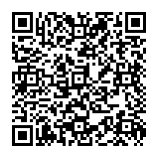
Short Survey
Thank you for attendings today's presentation. Please complete this short survey to help us improve future training and presentations
Coia Safety & Consultative Services LLC
(330) 957-3533
Ncoia@CS2Safety.com
www.cs2safety.com
Notes:
“Thank you for investing your time in this conversation today. I hope you leave here with not just information, but inspiration — to connect more intentionally, mentor more deliberately, empower with purpose, and unify your teams through culture. Generational differences aren’t a problem to solve — they’re an opportunity to seize. And when we seize them, we don’t just build safer workplaces — we build stronger, more connected ones. Thank you.”
Express gratitude to the audience.
Summarize the four pillars one last time.
Reframe generational differences as opportunities.
End with a call to action and inspiration.

Slide 55

THANKS FOR BEING HERE TODAY
50/50 DRAWING
MAY’S WINNER: ZENO FRANCO

Slide 56
CHARITY SUBMISSIONS FOR FY 2027
We are accepting submissions for area organizations that would benefit from some additional funds to donate our 50/50 proceeds to.
Let Deb know if you have a group or organization in mind.

Slide 57
THANKS FOR ATTENDING
THE NEXT MEETING IS ON JUNE 9TH, 2026
Our LAST meeting for FY26.
UNTIL THEN….
BE SAFE OUT THERE! ☺
VOLUNTEER OPPORTUNITY JUNE 4TH
LET DEB KNOW

