Slide 1
Small Business Environmental Assistance Program
Kara Reynolds
Division of Air Pollution Control
March 10, 2026

Slide 2
Small Business Environmental Assistance Program (SBEAP)
Have you heard of or used Ohio EPA’s Office of Compliance Assistance and Pollution Prevention (OCAPP)?

Slide 3




What is sbeap?
Non-regulatory
Confidential Program*
Helping Small
Business &
Communities
*Most divisions are confidential

Slide 4
Sbeap confidentiality
By law, the Division of Air Pollution Control (DAPC) SBEAP cannot share information about our customers with Ohio EPA inspection or enforcement staff
This varies by division, so please check with your SBEAP compliance assistant
All SBEAP services are free

Slide 5
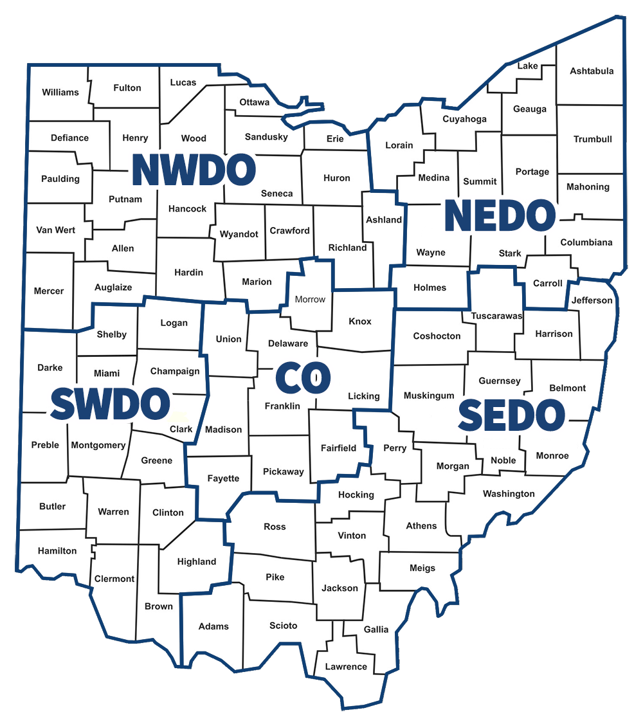

District Offices
Where to find SBEAP staff?
https://epa.ohio.gov/help-center/contact-list

Slide 6
SBEAP
Division of Air Pollution Control
Kara Reynolds 419.373.3066 Tamara Girard 330.963.1282
Division of Surface Water
Ynes Arocho 330.963.1203
Division of Materials and Waste Management
Madelyn (Maddie) Adams 937.285.6456
Division of Environmental Response and Revitalization
Amber Hicks 937.285.6439
Currently Vacant Position
Division of Drinking and Ground Waters
*Staff email = first name.last name@epa.ohio.gov

Slide 7

What is a small business?
100 employees or less
Non-major source of air pollution (non-Title V Facility)
Small business as defined by Small Business Administration
  Is organized for profit
  Has a place of business in the U.S.
  Operates primarily within the U.S. or makes a significant contribution to the U.S. economy through payment of taxes or use of American products, materials, or labor
  Is independently owned and operated and is not dominant in its field on a national basis

Slide 8

How can sbeap help you?
On-site compliance assessments
Phone consultations
Email us with questions

Slide 9
How can sbeap help you?
Help you understand what regulations apply
How to comply with applicable regulations
Assist you with
  Permit evaluations
  Permit applications
  Regulatory recordkeeping
  Regulatory reporting

Slide 10



Ohio EPA Permit Wizard
Online permitting and compliance tool
Notes:
Online Tool, Self Guided
Free and Confidential
Helps Determine Regulatory Requirements
General Requirements or Deeper Dive
Provides Helpful Guidance (Webpages, Guidance Sheets, Videos, Application Links,Contacts for Assistance)

Slide 11
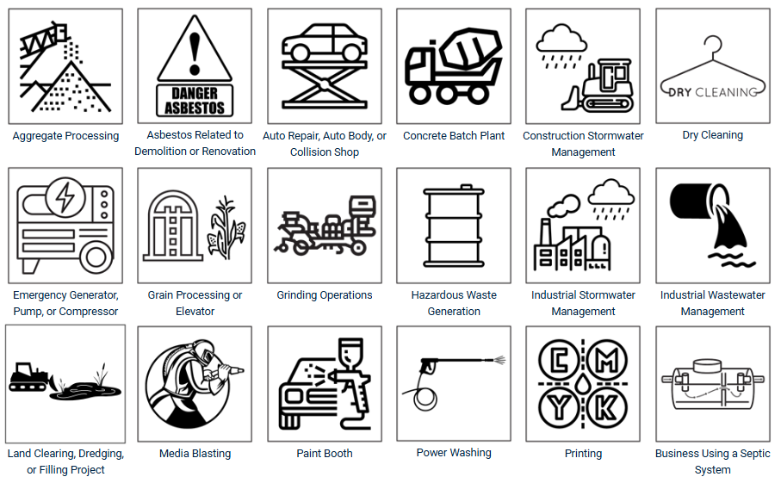

Slide 12
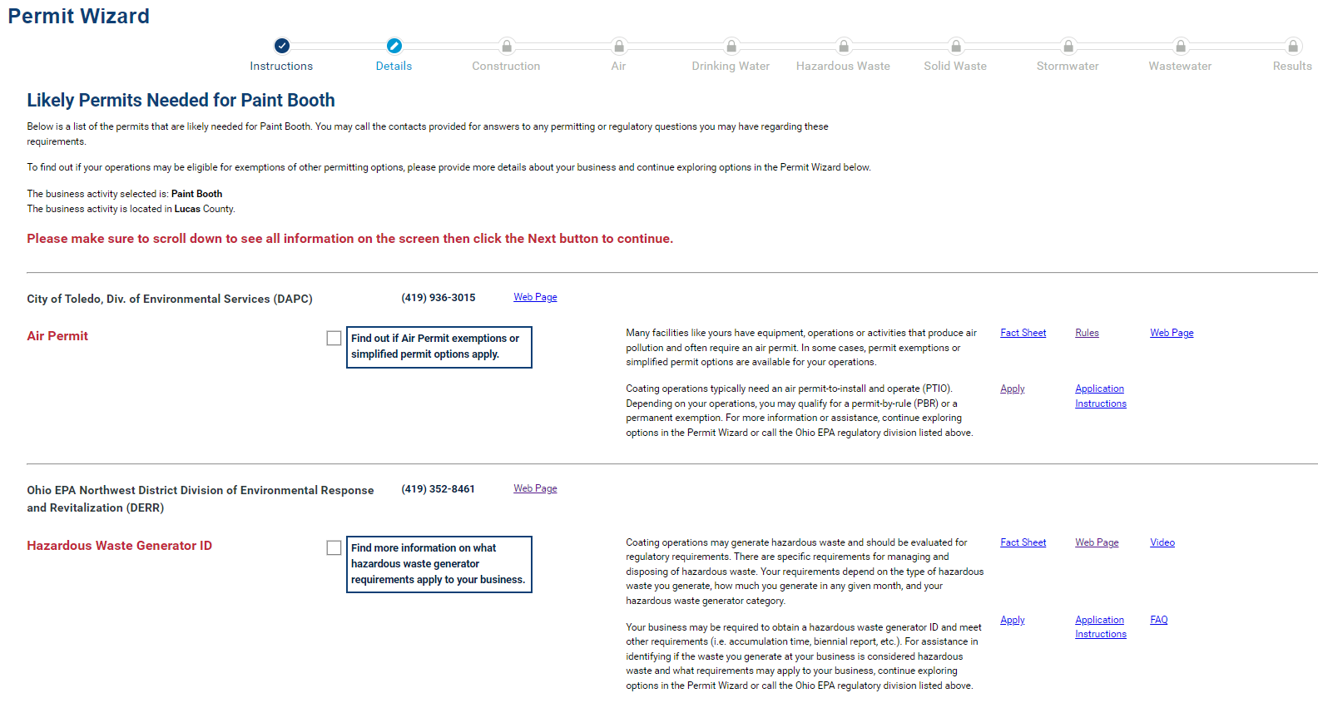
Permit Wizard – Paint Booth

Slide 13

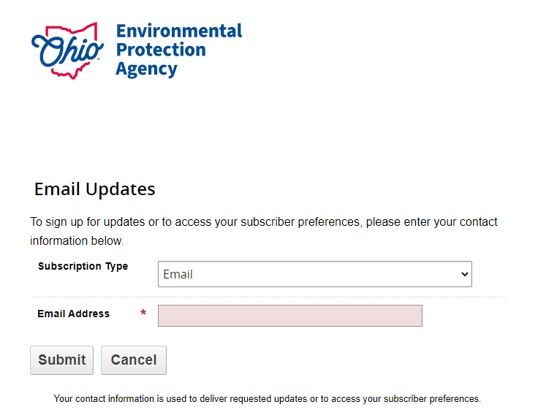

Subscribe for Updates

Slide 14
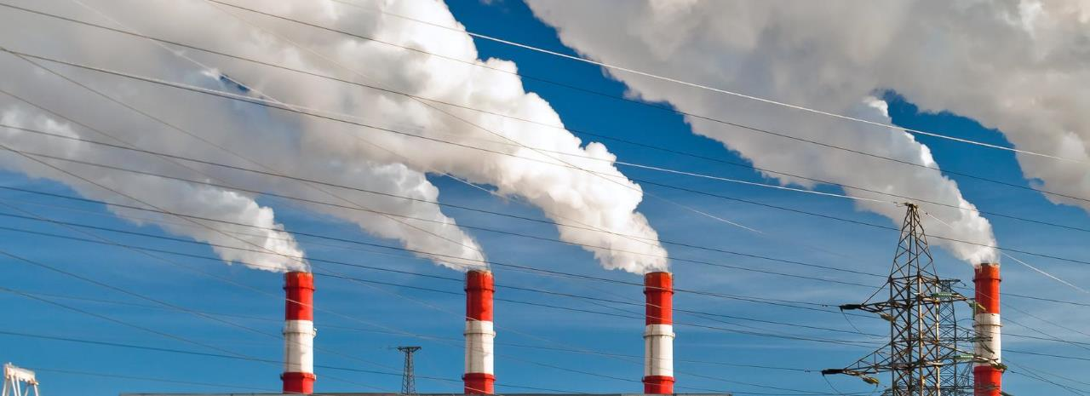
Air Permitting

Slide 15
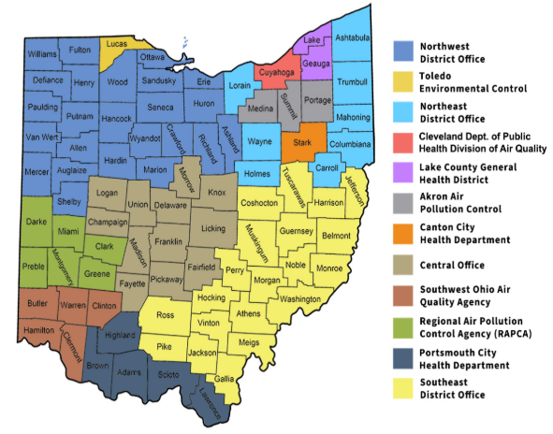
District Offices and local air agencies
Where to find regulatory staff?
https://epa.ohio.gov/help-center/contact-list

Slide 16

air pollution
Sources of air pollution need
an air permit…
unless they are exempt

Slide 17

What Needs an air permit?
No set list of what needs an air permit
Some exemptions exist
Need to evaluate your air pollution sources

Slide 18

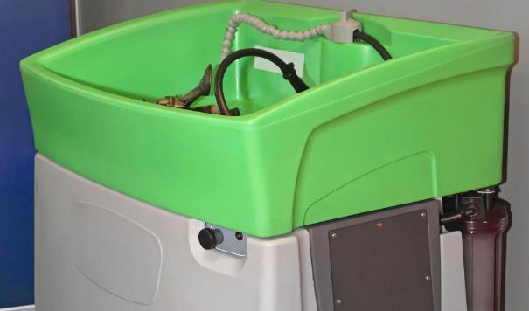
Common permitted sources
Spray Booth
Solvent Degreaser

Slide 19
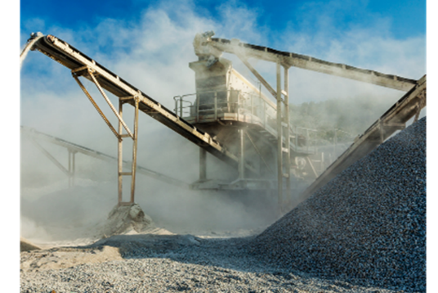
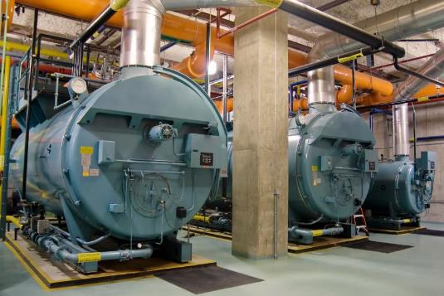
Common permitted sources
Aggregate Processing
Large Boilers

Slide 20


Common permitted sources
Solvent Dry Cleaning
Printing Operations

Slide 21
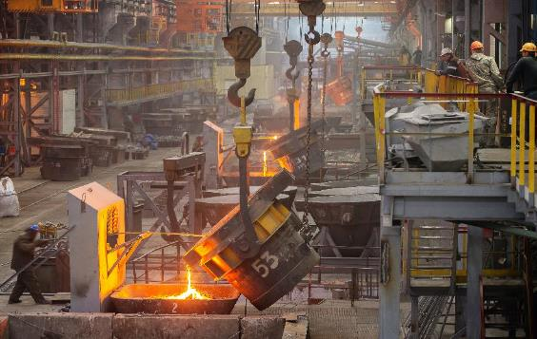
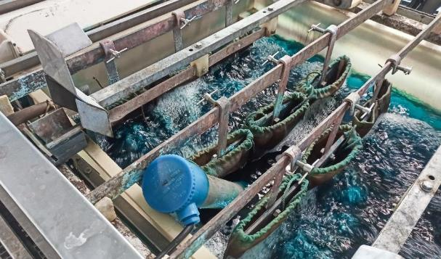
Common permitted sources
Foundry/Casting
Plating/Anodizing

Slide 22
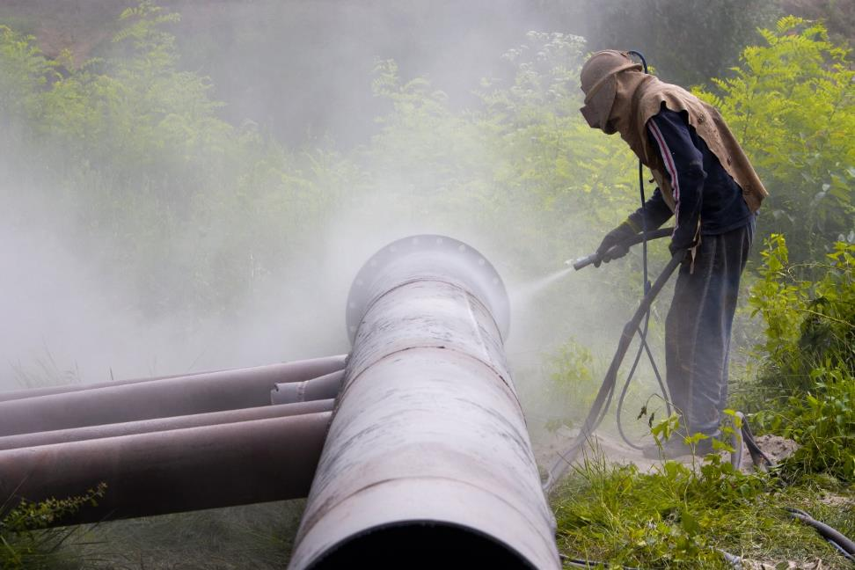

Common permitted sources
Abrasive Blasting
Roadways

Slide 23
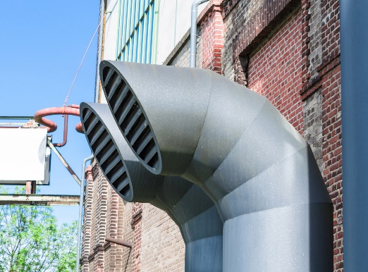

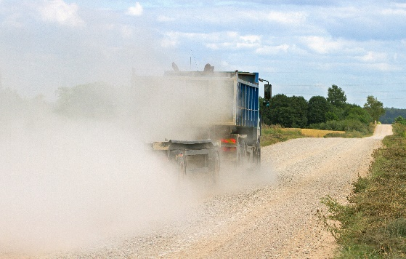
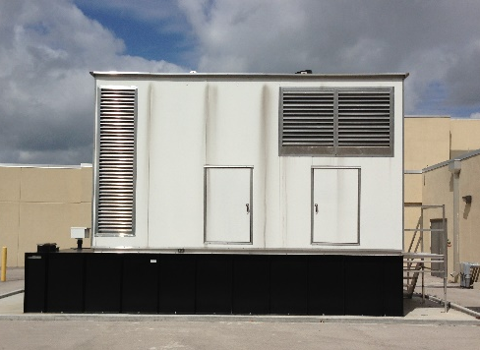
Does everything need an air permit?
NO, but you need to evaluate every source
Four rules of thumb for air permits
Something with a stack, vent, or dust collector
Something that uses solvents, paint, inks, or adhesives
Something that burns fuel
Something that causes smoke, dust, or odors

Slide 24
Does everything need an air permit?
NO
Permanent exemptions – 70+
  Small boilers, small solvent parts washers, certain roadways, etc.

Slide 25
Does everything need an air permit?
NO
Permanent exemptions – 70+
  Small boilers, small solvent parts washers, certain roadways, etc.
“De minimis” source exemption
  Emits less than 10 lbs/day of air pollutants

Slide 26
Types of Air Permits
1. Permit-by-Rule – (15)
  Pre-defined operating conditions and recordkeeping; one-page notification required, no waiting, and no fees
  Emergency generators, small crushers, auto body shops, etc.

Slide 27
Types of Air Permits
1. Permit-by-Rule – (15)
  Pre-defined operating conditions and recordkeeping; one-page notification required, no waiting, and no fees
  Emergency generators, small crushers, auto body shops, etc.
2. General Permit-to-Install and Operate (PTIO) – (15)
  “Canned permit” can view beforehand, available on website
  Dry cleaning, roadways, human crematories, etc.
  No calculations
  45 days

Slide 28
Types of Air Permits
1. Permit-by-Rule – (15)
  Pre-defined operating conditions and recordkeeping; one-page notification required, no waiting, and no fees
  Emergency generators, small crushers, auto body shops, etc.
2. General Permit to Install and Operate (PTIO) – (15)
  “Canned permit” can view beforehand, available on website
  Dry cleaning, roadways, human crematories, etc.
  No calculations
  45 days
3. Traditional PTIO
  1-6 months to get, depending on complexity
  One-time installation fee & biennial emissions fee thereafter
  Allows 18 months to start construction

Slide 29
Common air permit violations
Not evaluating all air pollution sources
Operating without an air permit
No or insufficient recordkeeping and reporting
Not re-evaluating permits needs if operations or equipment changes

Slide 30
Preventing air permit violations
Identify air pollution sources at your facility
Permit any sources not exempt
Read and understand your permit
Make recordkeeping as simple as possible
Re-evaluate as needed

Slide 31



Need help evaluating?
See our
Video Tutorial

Slide 32
Permit Evaluation Report (PER)
PER summarizes activity over 12-month period
for each emissions unit
Four possible periods:
Jan. 1 – Dec. 31;
due Feb. 15
April 1 – March 31;
due May 15
July 1 – June 30;
due Aug. 15
Oct. 1 – Sept. 30;
due Nov. 15

Slide 33
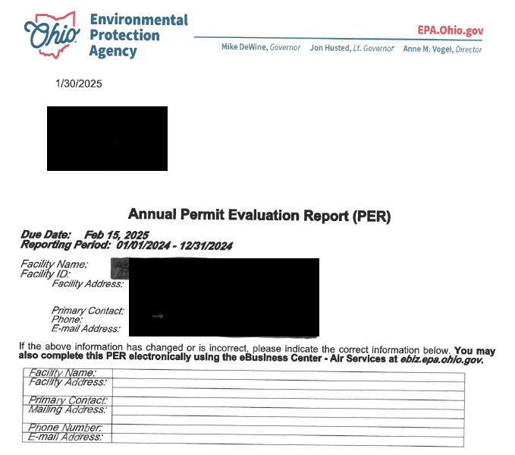
PER

Slide 34
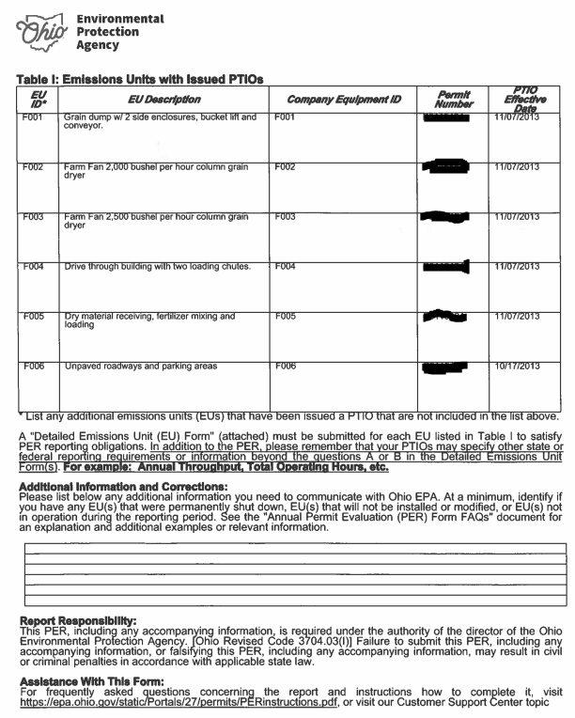
PER

Slide 35
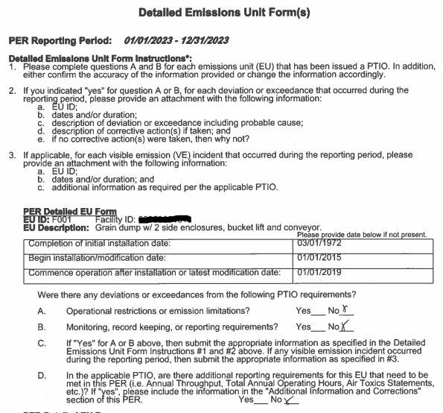
PER

Slide 36
Fee Emissions Report (FER)
FER summarizes emissions over
24-month period for facility
Due April 15

Slide 37
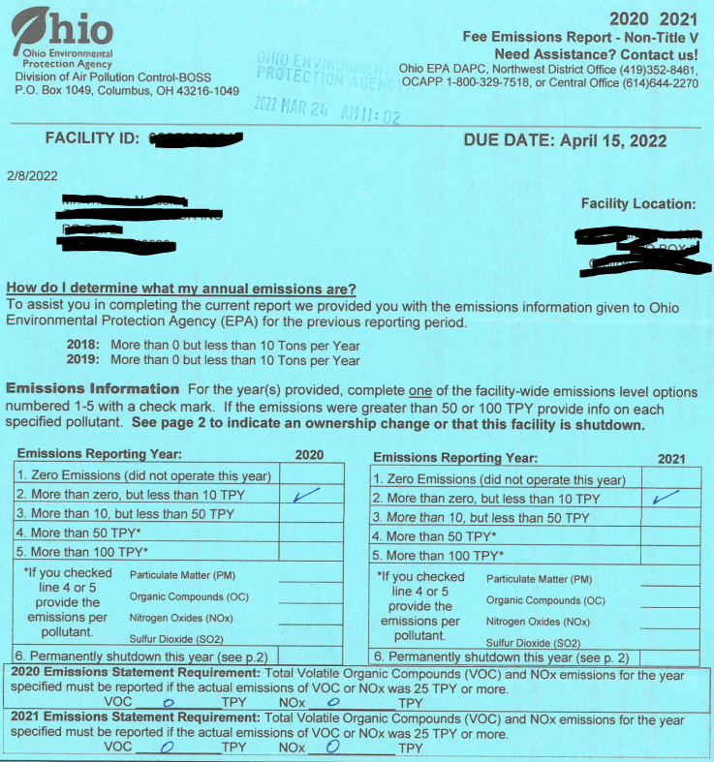
FER

Slide 38
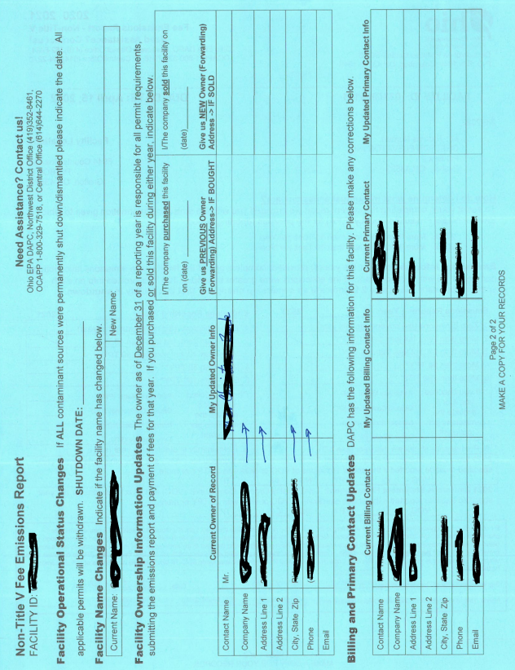
FER

Slide 39
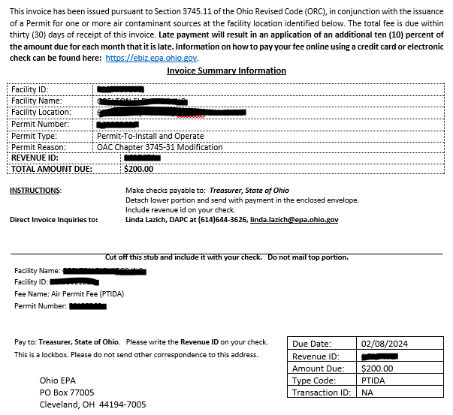
FER Invoice

Slide 40






Thank
Kara Reynolds
419.373.3066
kara.reynolds@epa.ohio.gov
You
Follow Ohio EPA on

Slide 41

Basics of Hazardous Waste
Amber Hicks
Division of Environmental Response and Revitalization (DERR)
Small Business Environmental Assistance Program (SBEAP)
March 10, 2026

Slide 42
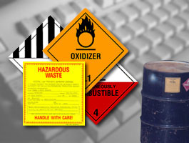
What We Will Cover
Hazardous Waste Characterization
Generator Categories
Generator Requirements
Universal Waste and Used Oil Rules
Commonly Cited Violations
Resources

Slide 43
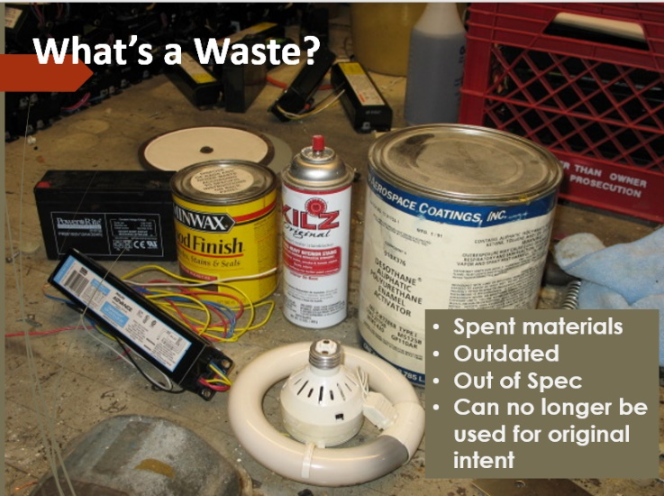
Solid Wastes & Hazardous Wastes
Solid Waste
Does not have to be
“solid”
Anything that you
Are discarding
and has no value
Hazardous Waste
Must be a Solid Waste
Also: Listed and/or
Characteristic

Slide 44
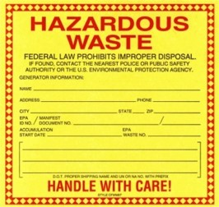
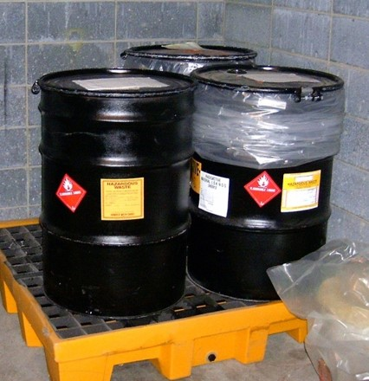
Do you generate hazardous waste?
What is a Hazardous Waste?
Is it a solid waste?
Is it a listed hazardous waste?
Does it exhibit a hazardous characteristic?
 Ignitability  Corrosivity
 Toxicity  Reactivity

Slide 45

Waste Evaluation Requirements
Resources may include:
  Lab analysis
    Toxicity Characteristic Leaching Procedure (TCLP)
  Generator knowledge
    Information from vendor/supplier
    Safety Data Sheets (SDS)
    Process information
**Must keep waste evaluation documentation on-site for at least 3 years.
Notes:
Lead = D008; blast media clean lead parts

Slide 46
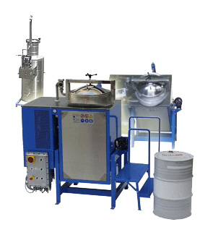
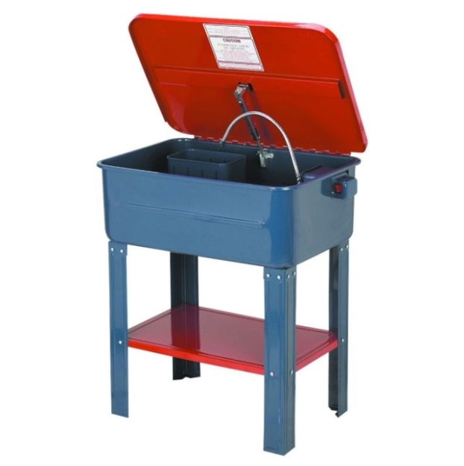
F Listed Hazardous Wastes
Non-specific sources
  Meaning from any type of process
Examples
  Spent solvents / Parts washer solvents
    F001, F002, F003, F004, F005
    Solvents with methylene chloride, xylene, toluene, etc.
    Ohio Administrative Code (OAC) rule 3745-51-31
Notes:
Xylene – F003; toluene F005; acetone F003
Explain briefly haz wastes assigned codes

Slide 47




Characteristic Hazardous Wastes
Ignitable (D001)
Corrosive (D002)
Reactive (D003)
Toxic (D004-D043)
Notes:
Lead = D008; 5.0 mg/L
40 (D004-D043)

Slide 48
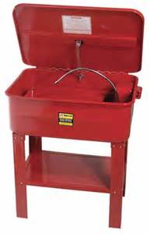
For example: Ignitable Hazardous Wastes
Flash point <140 F
Usually a liquid
D001 hazardous waste code
  Examples include:
    Degreasers
    Solvents (parts washers)
    Waste fuels
Notes:
Fuels – benzene; D018; 0.5 mg/L

Slide 49
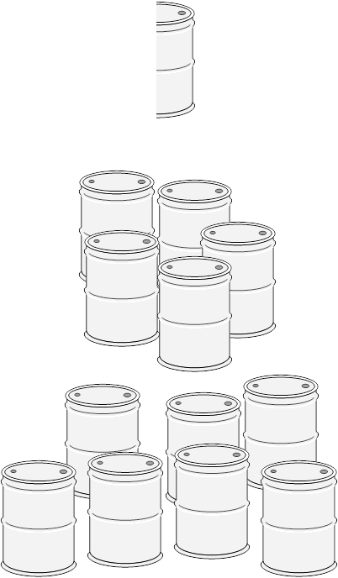
3 Hazardous Waste Generator Categories
Very Small Quantity Generator (VSQG)
< 220 lbs./month (about ½ of a 55-gallon drum)
< 2.2 lbs./month of “acute” hazardous waste
Never accumulates > ~ 5, 55-gallon drums onsite
Small Quantity Generator (SQG)
220 to 2,200 lbs./month (½ up to 5, 55-gallon drums)
Never accumulates ~ 30, 55-gallon drums onsite
Large Quantity Generator (LQG)
≥ 2,200 lbs./month (over ~ 5, 55-gallon drums)
> 2.2 lbs./month of “acute” hazardous waste

Slide 50
Determining Your Category
Total weight of hazardous waste that you generate (create) in any given month of the calendar year
  For example: Hazardous waste that you generate between March 1- March 31
  AND
  Total amount of hazardous waste on-site at any given time (only for VSQGs and SQGs)
NOTE: Generator categories are NOT determined by the weight of hazardous waste shipped off-site or by averaging
Do not count universal wastes or used oil
Notes:
Generated: count waste when removed from process; no longer usable product
10, 000 lbs. off – first shipment in 10 months example

Slide 51
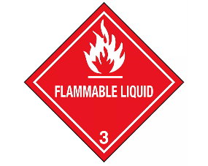
VSQG Requirements
< 220 lbs./month
Evaluate your wastes and keep documentation available
Don’t accumulate onsite more than 2,200 lbs. (~ five, 55-gallon drums)
Ensure delivery of hazardous waste to an appropriate authorized facility
Cannot ship to another VSQG or SQG, but can ship to an LQG* under the control of the same person for consolidation (must label containers “Hazardous Waste” and indicate hazards)
*LQG receiving must notify Ohio EPA

Slide 52
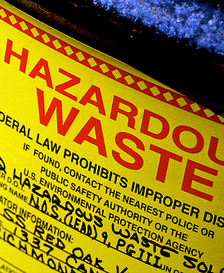
SQG Requirements
220 lbs./month to 2200 lbs./month
Obtain an ID number
Renotify every four years - next notification due 9/1/29
Evaluate your wastes and keep documentation for three years
Don’t accumulate more than 13,200 lbs. onsite (~ 27, 55-gallon drums)
Manifest and land disposal restrictions (LDRs) – to a hazardous waste treatment, storage, disposal facility (TSDF)
Container management & labeling applies e.g., “Hazardous Waste” and indication of hazards

Slide 53
SQG Requirements
220 lbs./month to 2200 lbs./month
Do not store waste over 180 days
Weekly container storage area inspections
Satellite accumulation
Emergency equipment
Emergency preparedness and prevention – emergency coordinator
Employee hazardous waste training
Pre-transport requirements/labeling
HW tank rules
Keep records for at least 3 years
Notes:
Back up for container inspections & emerg. Coord. if out/vacation, etc.

Slide 54

LQG Requirements
≥ 2,200 lbs./month
Obtain an ID number
Evaluate your wastes and keep documentation for three years
Manifest and LDRs – to a hazardous waste treatment, storage, disposal facility (TSDF)
Container labeling applies e.g., “Hazardous Waste” and indication of hazards
Container management – AA, BB, CC air emissions
Weekly container area inspections
Closure for HW central accumulation areas
Notes:
AA – process vents; BB – equipment; CC container/tanks – waste w/ certain amount of VOCs

Slide 55
LQG Requirements
≥ 2,200 lbs./month
Do not store waste over 90 days
Satellite accumulation
Emergency equipment
Contingency plan, including a quick reference guide
Emergency procedures
Personnel hazardous waste training
Pre-transport requirements/labeling
Notes:
Back up emerg. Coordinator in cont. plan / back up inspections

Slide 56
LQG Requirements
≥ 2,200 lbs./month
HW tank rules
HW consolidation from VSQGs – must notify
Keep records for at least 3 years
Biennial reports (& renotification) – due even number years for odd years
  3/1/26 for 2025
Notes:
Less HW generation; less requirements – show by number of slides

Slide 57
Episodic Generation – VSQG & SQG
Episodic Provisions:
Generators are allowed up to 2 events per year without changing their generator category
  one planned – e.g., lab or tank cleanout
  one unplanned event – accidental spill cleanup
  Notify using Form 9029 & Episodic Generator Addendum Form
Planned: Notify Ohio EPA at least 30 days prior to generation of waste
Unplanned: Notify Ohio EPA within 72 hours via phone,
email, or fax & subsequently submit forms

Slide 58
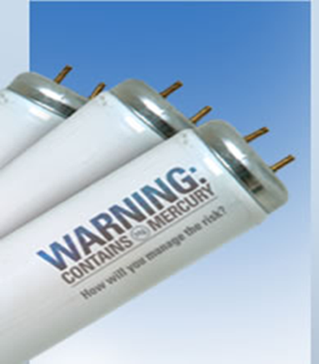
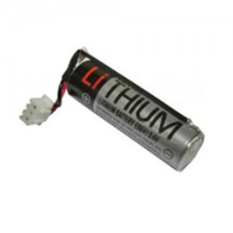
Universal Waste Rules
Subset of hazardous waste rules
Intended to promote recycling by reducing regulatory requirements
7 waste streams
Antifreeze – Ohio-specific
Paint and paint-related waste (includes inks) – Ohio-specific
Mercury-containing devices
Recalled or suspended pesticides
Aerosol cans
Fluorescent lights (including LEDs)
Batteries
May reduce your hazardous waste requirements!

Slide 59

Universal Waste Requirements
Label: “Waste” “Universal Waste” or “Used” followed by type
  E.g., “Waste Lamps” “Universal Waste Batteries” “Used Aerosol Cans”
  Paint & Antifreeze (Ohio-specific) – label just must identify what’s inside
Container closed, in good condition, waste compatible
All spills immediately cleaned up
Provide basic training on UW management
Don’t accumulate more than a year
Disposed at an appropriate facility (recycling recommended)

Slide 60
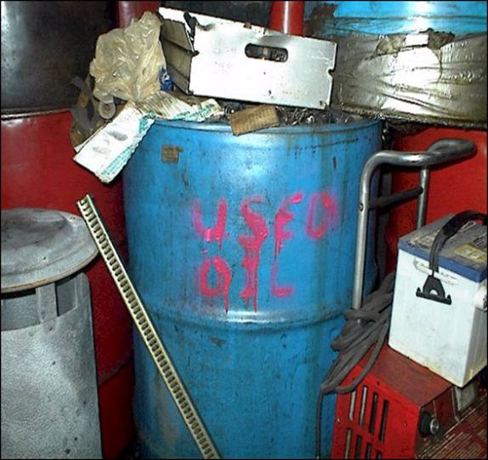

Used Oil Rules
Label tanks & containers “Used Oil”
Promptly clean up spills
Used oil containers and tanks must be in good condition
Properly dispose (recycle) your used oil
Don’t mix with other wastes/haz wastes
Take to a used oil collection center (transport 55-gallons or less) or
Have picked up by used oil recycler or
Burn your own used oil onsite in used oil burner if meet certain criteria
Doesn’t count toward hazardous waste generation!
Notes:
Testing, notification, record keeping

Slide 61


Most Cited Violations
Failure to evaluate your waste
Universal Waste related violations
  Not labeling used oil containers, tanks, or fill pipes
Not properly managing containers or maintaining an inspection log
Not testing or maintaining emergency equipment
Not filing your biennial report or filing incorrectly – LQG

Slide 62
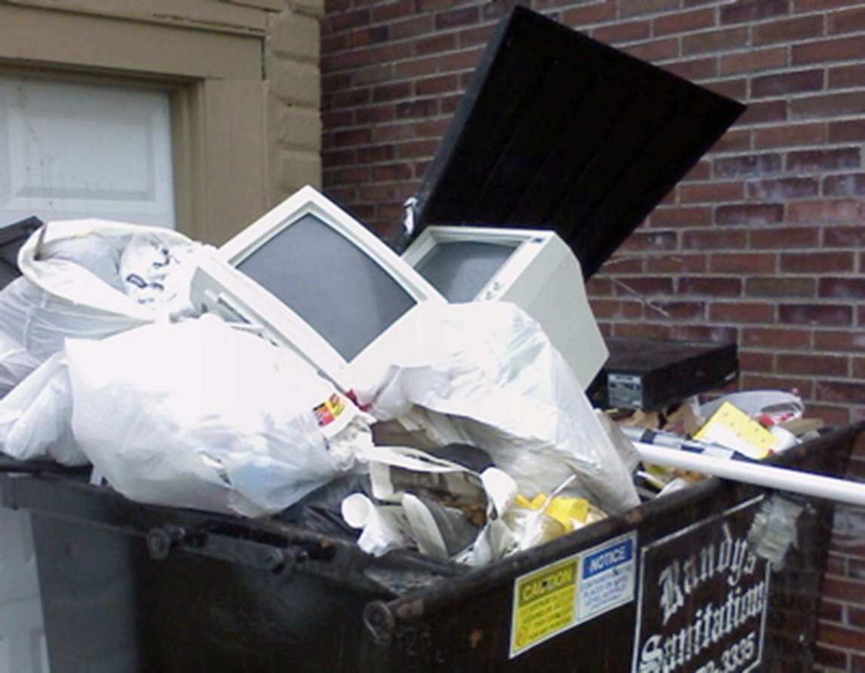
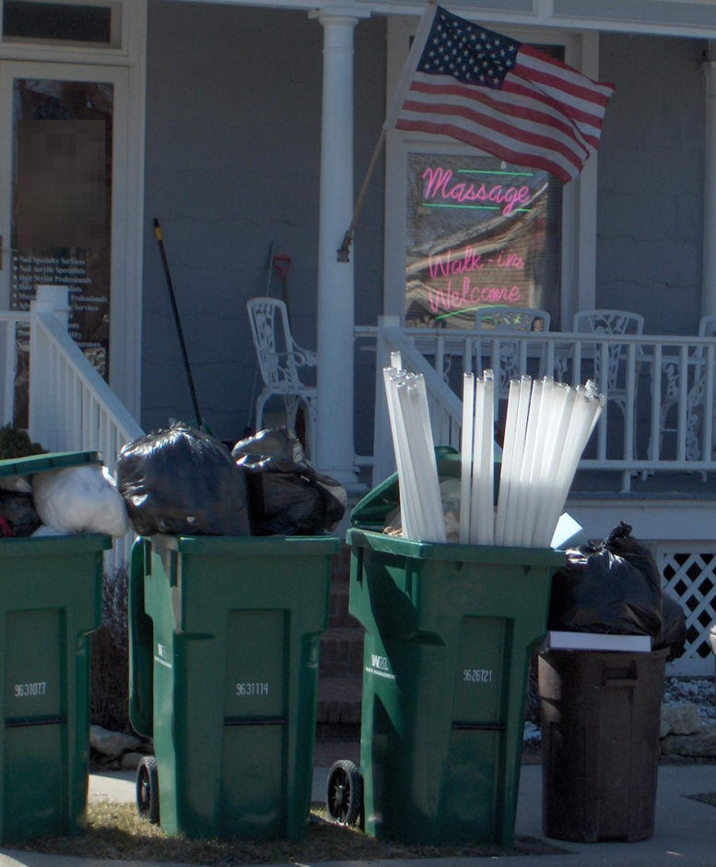
Hazardous Waste Determination
REMEMBER IF IN DOUBT DON’T THROW IT OUT!
Ohio Administrative Code (OAC) rule 3745-52-11
Notes:
Automatic enf. Referral if HW in trash. D008/spent blast media example

Slide 63
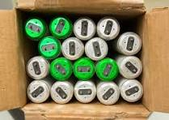


Avoiding Universal Waste Violations
Label Exact Wording
“Waste” “Universal Waste” “Used” followed by type
  E.g., “Waste Lamps” “Universal Waste Batteries” “Used Aerosol Cans”
  Paint & Antifreeze (Ohio-specific) – label just must identify what’s inside
Keep containers CLOSED unless adding or removing
No open-ended cardboard box of used lamps!

Slide 64
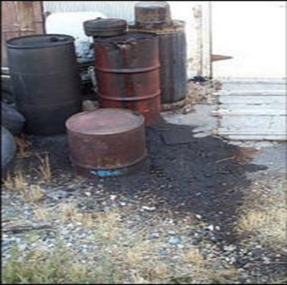
Avoiding Used Oil Violations
Labeling tanks and containers with the words
“Used Oil”
Do Not label as “Waste Oil” or “Hazardous Waste”
Containers and tanks must be in good condition
Releases – be sure to clean up immediately
OAC rule 3745-279

Slide 65
Avoiding Container Management violations
Keep containers closed while in storage - SQG, LQG
Do not open, handle, or store containers in a manner that will cause them to rupture or leak
Conduct inspections of container storage areas, at least weekly (Sunday to Saturday), looking for signs of leaks or deterioration – SQG, LQG
Recommend record inspections in a log or summary (SQG, LQG)
OAC rule 3745-52-16 (SQG)
OAC rule 3745-17 (LQG)

Slide 66
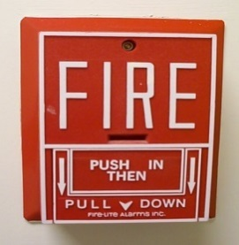
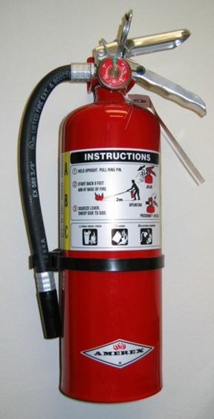
Avoiding Emergency Equipment violations
Alarm systems, fire protection equipment, spill control equipment, and decontamination equipment must be tested and maintained “as necessary” to ensure proper operation in time of emergency
Recommend record inspections in log or summary – SQG, LQG
OAC rule 3745-52-16 (SQG)
OAC rule 3745-253 (LQG)

Slide 67

Avoiding Violations - Biennial Reporting
LQGs only
OAC rule 3745-52-41
Due by March 1 of each even numbered year
Only report hazardous waste, not universal waste or used oil
Cover generator activities for the previous calendar year
Check accuracy and completeness

Slide 68
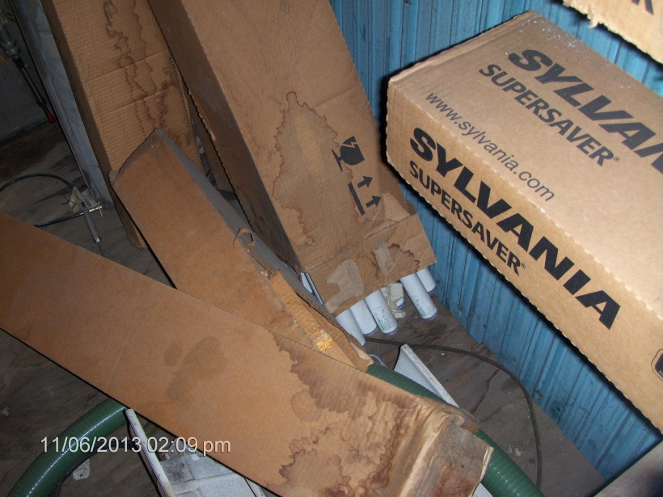
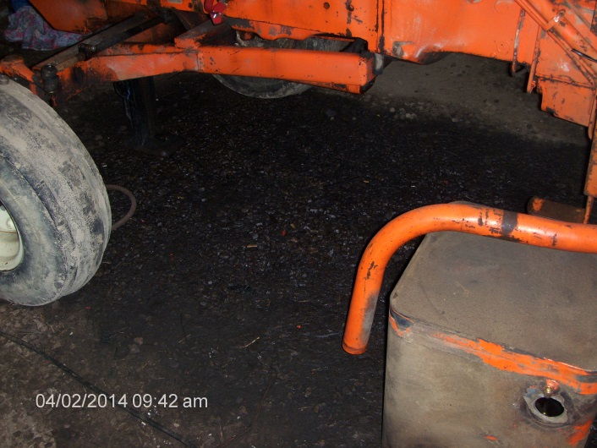
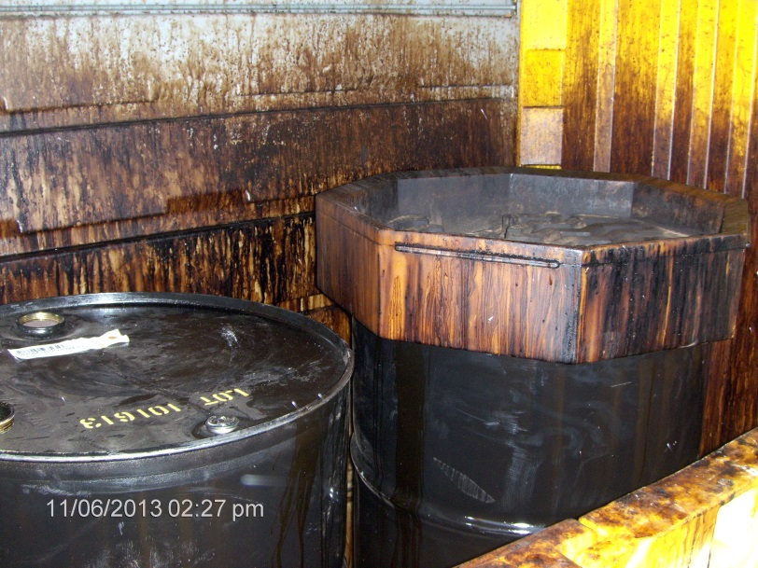
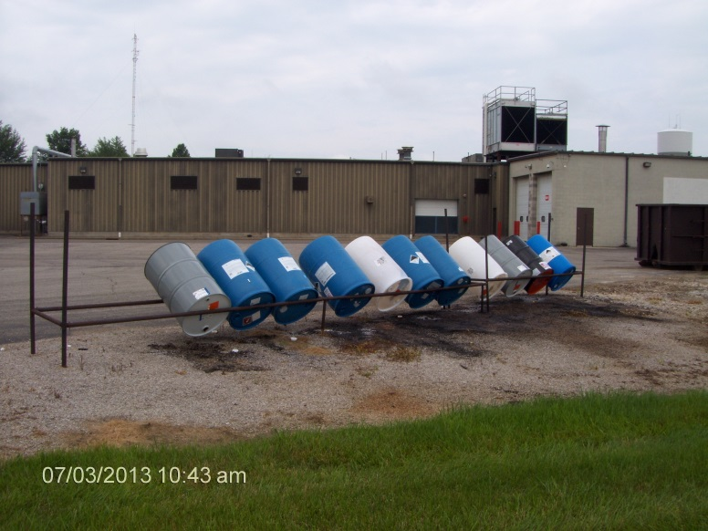
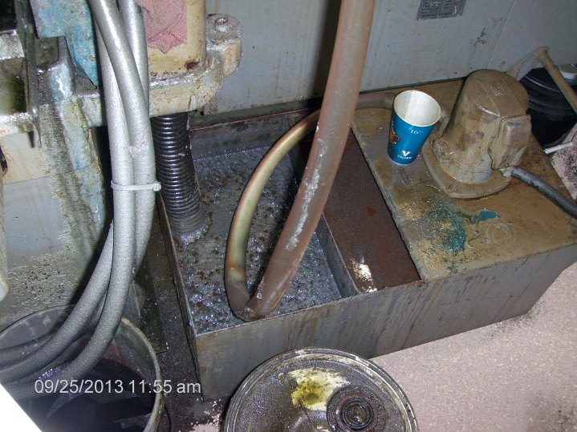
Good General Housekeeping is Key

Slide 69
Resources
Hazardous Waste | Ohio Environmental Protection Agency – Ohio EPA Hazardous Waste Website
Hazardous Waste Generator Requirements | Ohio Environmental Protection Agency – Guidance and Checklists
Hazardous Waste Generator Handbook
Generator Requirements Table
Managing your Hazardous Waste: A Guide for Small Businesses (U.S. EPA)

Slide 70




Thank
Amber Hicks
SBEAP, Hazardous Waste
937.285.6439
Amber.Hicks@epa.ohio.gov
You
Follow Ohio EPA on

